Slide 1
Population Health Management
Midlands Analyst Network Huddle – Population Health Management (PHM): An Introductory Overview
11am, 25 March 2020
Andi Orlowski
Director of the Health Economics Unit
Senior Population Health Analytics Advisor – NHS England (Data and Analytics Directorate)

Slide 2
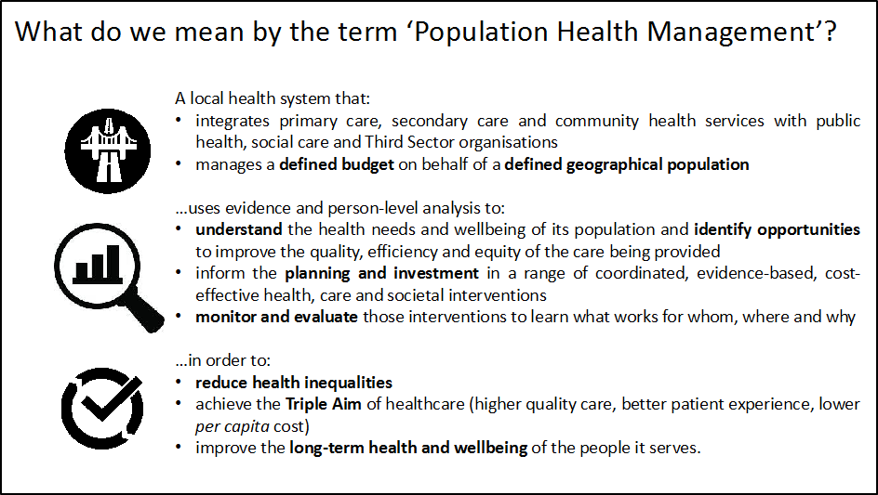

Slide 3
How is PHM different?
NHS
  Focused resource planning on those already consuming resources and often through the lens of specific diseases
Public health
  Promoting, preventing, protecting and prolonging healthy life through coordinated programmes, normally offered to the whole population
Population health management
  PHM focuses our planning on wider determinants of health and requires us to look at the healthy population, addressing inequalities in care and intervening more actively to promote wellbeing and prevent ill health and focus on best use of resources.

Slide 4
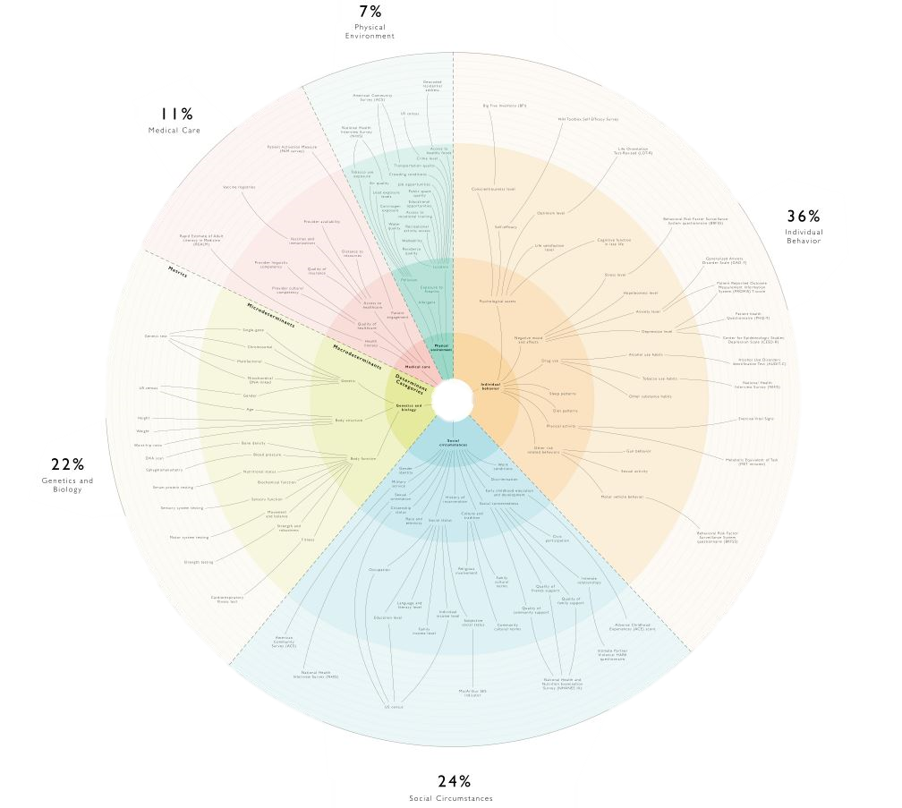
Notes:
Medical care accounts for only 10 to 20 per cent of modifiable contributors to population health.⁴ These social determinants of health (SDH) ‒ the conditions in which people are born, grow, live, work and age ‒ also contribute. Individual health behaviours contribute around 30 per cent of modifiable factors, socioeconomic factors roughly 40 per cent, and physical environment around 10 per cent.
Hood CM, Gennuso KP, Swain GR, Catlin BB. County health rankings: relationships between determinant factors and health outcomes. Am J Prev Med 2016; 50: 129‒135. https://doi.org/10.1016/j.amepre.2015.08.024.

Slide 5
Segmentation
Population segmentation is the process of grouping together individuals within a population into subgroups ‘segments’ based on specific characteristics
Each segment should have classifying features that make it distinct from the others
As a general rule, people should be assigned to one segment only

Slide 6
Why segment?
Summary statistics only tell, you so much
  X number of monthly nurse visits in a population of similar patients
  Average cost
  The result provides a simple measure against which to compare future outcomes.
Complex systems need a better understanding
  populations containing people with lots of different needs
  unevenly distributed numbers in different categories
  or outliers with particularly good or bad outcomes

Slide 7
Why segment?
In these situations, measuring system performance at sub-population levels can allow systems to work methodically through the entire population. Directing resources as needed
Allows investigation into how each segment interacts with a system and development of strategies tailored according to those characteristics
To move away from reactive strategies to those that are both proactive and reactive
Allows for predictions and plans to be made that will benefit the specific subgroup and facilitate the goals of more personalised care

Slide 8
Methods of population health segmentation
Whole population segmentation (used in 18 studies) | Segmentation of a whole population in order to achieve a homogeneous group that shares some characteristics.
Audience segmentation (used in 16 studies) | The process of identifying or disaggregating a large and heterogenous population into a more homogenous group with a targeted message.
Outcome based segmentation (used in 8 studies) | The process of segmenting the population by use of the outcomes of interest.
Geodemographic segmentation (used in 6 studies) | Classifying neighbourhood household types and person types based on demographic data.
Notes:
King’s Fund - Julia Cream literature search
Search results
Low, L.L., Yan, S., Kwan, Y.H., Tan, C.S. and Thumboo, J., (2018). Assessing the validity of a data driven segmentation approach: A 4 year longitudinal study of healthcare utilization and mortality. PLOS ONE, 13(4), p.e0195243.
http://journals.plos.org/plosone/article?id=10.1371/journal.pone.0195243 [Accessed July 5, 2018]
Background Segmentation of heterogeneous patient populations into parsimonious and relatively homogenous groups with similar healthcare needs can facilitate healthcare resource planning and development of effective integrated healthcare interventions for each segment. We aimed to apply a data-driven, healthcare utilization-based clustering analysis to segment a regional health system patient population and validate its discriminative ability on 4-year longitudinal healthcare utilization and mortality data. Methods We extracted data from the Singapore Health Services Electronic Health Intelligence System, an electronic medical record database that included healthcare utilization (inpatient admissions, specialist outpatient clinic visits, emergency department visits, and primary care clinic visits), mortality, diseases, and demographics for all adult Singapore residents who resided in and had a healthcare encounter with our regional health system in 2012. Hierarchical clustering analysis (Ward’s linkage) and K-means cluster analysis using age and healthcare utilization data in 2012 were applied to segment the selected population. These segments were compared using their demographics (other than age) and morbidities in 2012, and longitudinal healthcare utilization and mortality from 2013–2016. Results Among 146,999 subjects, five distinct patient segments “Young, healthy”; “Middle age, healthy”; “Stable, chronic disease”; “Complicated chronic disease” and “Frequent admitters” were identified. Healthcare utilization patterns in 2012, morbidity patterns and demographics differed significantly across all segments. The “Frequent admitters” segment had the smallest number of patients (1.79% of the population) but consumed 69% of inpatient admissions, 77% of specialist outpatient visits, 54% of emergency department visits, and 23% of primary care clinic visits in 2012. 11.5% and 31.2% of this segment has end stage renal failure and malignancy respectively. The validity of cluster-analysis derived segments is supported by discriminative ability for longitudinal healthcare utilization and mortality from 2013–2016. Incident rate ratios for healthcare utilization and Cox hazards ratio for mortality increased as patient segments increased in complexity. Patients in the “Frequent admitters” segment accounted for a disproportionate healthcare utilization and 8.16 times higher mortality rate. Conclusion Our data-driven clustering analysis on a general patient population in Singapore identified five patient segments with distinct longitudinal healthcare utilization patterns and mortality risk to provide an evidence-based segmentation of a regional health system’s healthcare needs.
Fell, G., (2018). Building a population health management system. Sheffield DPH.
https://gregfellpublichealth.wordpress.com/2018/06/05/building-a-population-health-management-system/
I thought I’d pretty much all I know on on “population health management” – see the tagged blogs. I thought I’d run out of things to say but then someone asked me an interesting question that made me think. The question was along the lines of “ahhh this is all very interesting and useful but what so I have to ‘do’.” THE AUTHOR IS DPH IN SHEFFIELD
Lewer, D., Bourne, T., George, A., Abi-Aad, G., Taylor, C. and George, J., (2018). Data Resource: the Kent Integrated Dataset (KID). International Journal of Population Data Science, 3(1).
https://ijpds.org/article/view/427/389 [Accessed July 5, 2018]
Introduction: Electronic healthcare records from the UK are accessible to researchers via a number of platforms, but these platforms typically include data from a limited subset of health and care services. The Kent Integrated Dataset (KID) aims to provide insight into system-wide health and care utilisation for the whole population of Kent and Medway. Methods: The KID uses pseudonymisation-at-source to link patient-level records from services including general practices, hospitals, community health services and social care. The design and governance of the dataset is led by local authorities, health commissioners and service providers. Results: A population-level dataset has been developed, including data from April 2014 onwards. Data providers add new data on a monthly basis. The KID has been used to understand the costs associated with frailty, estimate the prevalence of rare conditions and compare the risk of non-elective hospitalisation between general practices. Conclusion: The KID is a unique and rich dataset available to researchers who are investigating a broad range of public health questions. It provides system-level insight into patient journeys and care utilisation and supports commissioning based on patient needs.
Rosen, R., (2018). Divided we fall: getting the best out of general practice, London: Nuffield Trust.
https://www.nuffieldtrust.org.uk/research/divided-we-fall-getting-the-best-out-of-general-practice
This report explores the effect of recent policy to segment general practice into different types of service tailored to the needs of different patients. It looks at the tensions between this new approach and the traditional GP role of ‘medical generalism’ in a service with constrained resources and argues that if medical generalism is undermined, the value that general practice achieves for the NHS will reduce. The work draws on themes from a recent Nuffield Trust seminar, relevant literature and earlier work carried out by the Trust
Green, D.E., Hamory, B.H., Terrell, G.E. and O’Connell, J., (2017). A Case Report: Cornerstone Health Care Reduced the Total Cost of Care Through Population Segmentation and Care Model Redesign. Population Health Management, 20(4), pp.309–317.
Over the course of a single year, Cornerstone Health Care, a multispecialty group practice in North Carolina, redesigned the underlying care models for 5 of its highest-risk populations-late-stage congestive heart failure, oncology, Medicare-Medicaid dual eligibles, those with 5 or more chronic conditions, and the most complex patients with multiple late-stage chronic conditions. At the 1-year mark, the results of the program were analyzed. Overall costs for the patients studied were reduced by 12.7% compared to the year before enrollment. All fully implemented programs delivered between 10% and 16% cost savings. The key area for savings factor was hospitalization, which was reduced by 30% across all programs. The greatest area of cost increase was ‘other,’ a category that consisted in large part of hospice services. Full implementation was key; 2 primary care sites that reverted to more traditional models failed to show the same pattern of savings.
Parkinson, D., (2017). A Method for Population Segmentation by Event Based Machine Learning. Technical Disclosure Commons.
https://www.tdcommons.org/dpubs_series/641
The present disclosure provides systems and methods for automating the process of segmentation analytics for users of an application. Segmentation analysis involves the bucketing of individuals (users) into different groups each describing the type of user, usage, and/or interactions the group exhibits with the application. Such knowledge allows businesses to better understand and support specific user group’s needs. Existing methods of segmentation analysis involve multiple manual steps: (1) define groups; (2) build a list of business rules to calculate the correct categorization for each user; (3) execute the algorithm over all users; and (4) repeat the process to update users as new users join and previous users change groups over time. As the number of users and variance between groups increase within an application, each step becomes more expensive and less sustainable. With nearly unlimited uses it becomes very difficult to know how users are interacting with the application and which are using it the most.
Chong, J.L. and Matchar, D.B., (2017). Benefits of Population Segmentation Analysis for Developing Health Policy to Promote Patient-Centred Care. Annals of the Academy of Medicine, Singapore, 46(7), pp.287–289.
http://www.annals.edu.sg/pdf/46VolNo7Jul2017/V46N7p287.pdf
Kyriazis, D., Autexier, S., Brondino, I., Boniface, M., Donat, L., Engen, V., Fernandez, R., Jimenez-Peris, R., Jordan, B., Jurak, G., Kiourtis, A., Kosmidis, T., Lustrek, M., Maglogiannis, I., Mantas, J., Martinez, A., Mavrogiorgou, A., Menychtas, A., Montandon, L., Nechifor, C.-S., Nifakos, S., Papageorgiou, A., Patino-Martinez, M., Perez, M., Plagianakos, V., Stanimirovic, D., Starc, G., Tomson, T., Torelli, F., Traver-Salcedo, V., Vassilacopoulos, G. and Wajid, U., (2017). CrowdHEALTH: Holistic Health Records and Big Data Analytics for Health Policy Making and Personalized Health. Studies in Health Technology and Informatics, 238, pp.19–23.
Today’s rich digital information environment is characterized by the multitude of data sources providing information that has not yet reached its full potential in eHealth. The aim of the presented approach, namely CrowdHEALTH, is to introduce a new paradigm of Holistic Health Records (HHRs) that include all health determinants. HHRs are transformed into HHRs clusters capturing the clinical, social and human context of population segments and as a result collective knowledge for different factors. The proposed approach also seamlessly integrates big data technologies across the complete data path, providing of Data as a Service (DaaS) to the health ecosystem stakeholders, as well as to policy makers towards a ‘health in all policies’ approach. Cross-domain co-creation of policies is feasible through a rich toolkit, being provided on top of the DaaS, incorporating mechanisms for causal and risk analysis, and for the compilation of predictions.
Langton, J., Wong, S., Peterson, S. and McGrail, K., (2017). Developing population segments with different levels of complexity and primary health care needs: An analysis using health administrative data in British Columbia, Canada. International Journal of Population Data Science, 1(1).
https://ijpds.org/article/view/208/190 [Accessed July 4, 2018]
ABSTRACTObjectivesPopulation subgroups can be been used organize health services and understand the quality of health care. Most commonly, populations are have been by specific diseases (e.g., health care received by diabetes patients), patient age (e.g., elderly populations), or life-stage (e.g., end-of-life care). However, these subgroups may not adequately capture the complexity and/or health care needs of different patient groups (e.g., multi-morbidity, frail elderly). Our objective is to use health administrative data to develop population segments based on patients’ primary health care needs.&nbsp; ApproachOur development process occurred in three stages. First, we examined examples of population segmentation in the peer reviewed and grey literature to develop principles for our population segments. Second, we held a workshop with primary care patients, decision-makers, clinicians and researchers to seek their input on important considerations for the population segments. Third, we used health administrative data (physician claims, hospitalisations) to develop population segments for the British Columbia (BC, Canada) population. Segments were based on diagnosis codes over a two year period; for each segment we examined health care use and costs, overall and by service type, in 2014-15. ResultsWe designed our segments to be mutually exclusive, capture the vast majority of people who use primary care services, and range from healthy patients (fewer primary care needs) to more complex patients (more extensive needs). Stakeholders were supportive of population segmentation approach and suggested incorporating patient vulnerability and primary care involvement such that segments would range from patients whose needs could be fully met in primary care to those who require additional services such as specialists/acute care. Our first iteration includes three segments: stable (≤1 chronic condition, needs met by primary care); multi-morbid (≥2 chronic conditions, needs mostly met by primary care); and complex (≤1 chronic condition and presence of a health care event associated with the management of this condition suggesting the patients’ needs not fully met by primary care). ConclusionWe developed population segments designed to account for patient complexity and primary health care needs; as such, segments provide more information than traditional indices of morbidity burden based on counts of chronic conditions. These segments will be used to report information on the quality of primary care. We plan to include conduct validation studies using additional variables (e.g, socio-economic factors, level of vulnerability from patient surveys) so that segments more accurately represent the level of complexity and patients’ primary health care needs.
Pimperl, A., Schulte, T., Mühlbacher, A., Rosenmöller, M., Busse, R., Groene, O., Rodriguez, H.P. and Hildebrandt, H., (2017). Evaluating the Impact of an Accountable Care Organization on Population Health: The Quasi-Experimental Design of the German Gesundes Kinzigtal. Population Health Management, 20(3), pp.239–248.
https://www.liebertpub.com/doi/full/10.1089/pop.2016.0036
A central goal of accountable care organizations (ACOs) is to improve the health of their accountable population. No evidence currently links ACO development to improved population health. A major challenge to establishing the evidence base for the impact of ACOs on population health is the absence of a theoretically grounded, robust, operationally feasible, and meaningful research design. The authors present an evaluation study design, provide an empirical example, and discuss considerations for generating the evidence base for ACO implementation. A quasi-experimental study design using propensity score matching in combination with small-scale exact matching is implemented. Outcome indicators based on claims data were constructed and analyzed. Population health is measured by using a range of mortality indicators: mortality ratio, age at time of death, years of potential life lost/gained, and survival time. The application is assessed using longitudinal data from Gesundes Kinzigtal, one of the leading population-based ACOs in Germany. The proposed matching approach resulted in a balanced control of observable differences between the intervention (ACO) and control groups. The mortality indicators used indicate positive results. For example, 635.6 fewer years of potential life lost (2005.8 vs. 2641.4; t-test: sig. P < 0.05*) in the ACO intervention group (n = 5411) attributable to the ACO, also after controlling for a potential (indirect) immortal time bias by excluding the first half year after enrollment from the outcome measurement. This empirical example of the impact of a German ACO on population health can be extended to the evaluation of ACOs and other integrated delivery models of care.
Low, L.L., Kwan, Y.H., Liu, N., Jing, X., Low, E.C.T. and Thumboo, J., (2017). Evaluation of a practical expert defined approach to patient population segmentation: a case study in Singapore. BMC health services research, 17(1), p.771.
https://bmchealthservres.biomedcentral.com/articles/10.1186/s12913-017-2736-8
BACKGROUND: Segmenting the population into groups that are relatively homogeneous in healthcare characteristics or needs is crucial to facilitate integrated care and resource planning. We aimed to evaluate the feasibility of segmenting the population into discrete, non-overlapping groups using a practical expert and literature driven approach. We hypothesized that this approach is feasible utilizing the electronic health record (EHR) in SingHealth. METHODS: In addition to well-defined segments of ‘Mostly healthy’, ‘Serious acute illness but curable’ and ‘End of life’ segments that are also present in the Ministry of Health Singapore framework, patients with chronic diseases were segmented into ‘Stable chronic disease’, ‘Complex chronic diseases without frequent hospital admissions’, and ‘Complex chronic diseases with frequent hospital admissions’. Using the electronic health record (EHR), we applied this framework to all adult patients who had a healthcare encounter in the Singapore Health Services Regional Health System in 2012. ICD-9, 10 and polyclinic codes were used to define chronic diseases with a comprehensive look-back period of 5 years. Outcomes (hospital admissions, emergency attendances, specialist outpatient clinic attendances and mortality) were analyzed for years 2012 to 2015. RESULTS: Eight hundred twenty five thousand eight hundred seventy four patients were included in this study with the majority being healthy without chronic diseases. The most common chronic disease was hypertension. Patients with ‘complex chronic disease’ with frequent hospital admissions segment represented 0.6% of the eligible population, but accounted for the highest hospital admissions (4.33 ± 2.12 admissions; p < 0.001) and emergency attendances (ED) (3.21 ± 3.16 ED visits; p < 0.001) per patient, and a high mortality rate (16%). Patients with metastatic disease accounted for the highest specialist outpatient clinic attendances (27.48 ± 23.68 visits; p < 0.001) per patient despite their relatively shorter course of illness and high one-year mortality rate (33%). CONCLUSION: This practical segmentation framework can potentially distinguish among groups of patients, and highlighted the high disease burden of patients with chronic diseases. Further research to validate this approach of population segmentation is needed.
Kent County Council, (2017a). Kent Integrated Dataset (KID): Use of linked data for applied analytics to support service planning.
https://www.geoplace.co.uk/documents/10181/74436/Abraham+George-MAr2Wyt0.pdf/ed446bbe-d671-4244-8991-010f8e250057
Bedeman, J. and London Borough of Croydon, (2017). Live Well Croydon Programme : health impact assessment : final report., Croydon : LBC,.
https://www.cvalive.org.uk/assets/documents/16-02-17-live-well-croydon-fin
The Live Well Croydon programme is a new lifestyle offer that aims to make it easier for Croydon’s residents to look after their health and wellbeing. Croydon’s current lifestyle services are currently commissioned and delivered as separate services and the new Live Well Croydon programme is redesigning and integrating these services. This shift takes into account that those with most need for lifestyle behaviour change often have multiple issues and the new face to face programme, Just Live Well, is designed to target this. Access to face to face services will primarily be through completion of a health survey on the Just Be website, a new general population offer of lifestyle advice for multiple health behaviours. Any service change has potential wider effects on the health of the communities it serves, and a health impact assessment is undertaken to systematically try and assess any vulnerable groups that may be affected by the change and the wider determinants of health that they may be affected through. For this rapid health impact assessment a stakeholder workshop was undertaken to explore the potential vulnerable groups that may be adversely affected by the programme and come up with potential recommendations to mitigate these.
Great Britain. Department for Education and Beninger, K., (2017). Newcastle City Council’s Family Insights programme: research report., London: DfE.
https://www.gov.uk/government/publications/newcastle-city-councils-family-insights-programme [Accessed July 4, 2018]
Independent evaluation of the implementation and impact of Family Insights, a programme to support social workers to become agents and improve their capacity to support children and families. It aimed to do this by introducing needs-based segmented social work units to improve the provision of direct intervention and specialist support, better collection and analysis of data to provide social workers with a better picture of needs and outcomes, and a commitment to teaching and learning. The evaluation was carried out by Kantar Public (formerly TNS BMRB), between June 2015 and October 2016. The evaluation found that significant progress had been made in establishing the systems and processes needed to implement Family Insights, but it was too early to assess its effectiveness in improving outcome for children and families in relation to reduced demand at the most intensive tier of social care, reductions in re-referrals, and reductions in children’s social care costs. However the evaluation does highlight positive findings about the implementation of Family Insights and indications that the model has strengthened social work practice, including evidence of increased systemic practice by social workers. The report recommends that further independent monitoring and evaluation is undertaken over the next 2-5 years.
Vuik, S.I., (2017). On the application of data-driven population segmentation to design patient-centred integrated care. PhD. Imperial College London.
http://spiral.imperial.ac.uk/handle/10044/1/58341 [Accessed July 4, 2018]
Rationale: Retailers use segmentation methods to identify groups of distinct and homogeneous customers, tailoring their products and services to these groups. In healthcare, patient-centred integrated care also aims to design care models around the patient, but the use of data to support this is limited. Data-driven segmentation could be used to identify patients with similar care needs, who might benefit from integrated care initiatives. Aim: To define the potential role of data-driven population segmentation in designing patient-centred integrated care. Methods: Existing applications of segmentation in healthcare were explored through literature, case study and systematic reviews. Segmentation analyses were performed on a 300,000-patient database, containing primary and secondary care data. Methods included k-means cluster analysis, regression analysis, artificial neural networks and decision trees, in addition to descriptive and statistical analyses. Results: Several integrated care programmes apply segmentation, but their use of data-driven methods is limited. Nevertheless, there exist many healthcare studies that used cluster analysis to segment patient populations. Segmenting a whole population resulted in eight distinct care user segments, providing an evidence base for population health. Segmenting the subpopulation of patients with ACSC hospitalisations identified four different care utilisation patterns, each requiring different preventive interventions. Risk stratification is a segmentation method in itself, but descriptive segmentation can help to identify different groups within the high-risk population. Where no patient-level data is available, an a priori rule can be used to identify high-needs patients. Conclusion: Data-driven segmentation can play an important role in designing patient-centred integrated care. It can be used to describe different patient groups within a population, a subpopulation, or a high-risk population, and design integrated care interventions around the needs of each segment. It can also be used to predict which patients are in the target group for integrated care initiatives.
Fell, G., (2017). Population health management, revisiting segmentation. The use and abuse of risk stratification. Sheffield DPH.
https://gregfellpublichealth.wordpress.com/2017/12/24/population-health-management-revisiting-segmentation/
Population health management is all the rage. I’ve blogged on this a lot recently. This is a long, teccy blog. Largely based on something I wrote about 7 years ago. Basics haven’t changed since then. Thanks especially to Steve Laitner and Martin Vernon some of whose Ideas I have nicked. This blog focuses on segmentation, especially focused on predictive algorithm models for that. The author is DPH in Sheffield. THIS BLOG IS LINKED TO FROM AN NHS ENGLAND BLOG: https://www.england.nhs.uk/blog/a-population-health-management-approach-to-ageing/
Jean-Baptiste, D., O’Malley, A.S., Shah, T. and Mathematica Policy Research, (2017). Population segmentation and targeting of health care resources: findings from a literature review, Washington, DC : Mathematica Policy Research.
https://www.mathematica-mpr.com/-/media/publications/pdfs/health/2017/population-segmentation-wp58.pdf
Health care costs have grown steadily over the years, and a large percentage of these costs can be attributed to patients with multiple, complex health care needs. Studies note that while these “high-need, high-cost” (HNHC) patients make up to five percent of all patients in the nation, they account for nearly half of health care spending in a given year. Some health care organizations, particularly those taking on increased financial risk for their patients, are turning to population segmentation to help address this issue. Population segmentation seeks to efficiently targeting resources to the highest-risk, and potentially most costly, patients in health care organizations to improve quality of life and maximize efficient use of health care resources. This paper summarizes our review of the literature to identify health care delivery organizations’ approaches to segmenting their HNHC patients and using that information to tailor health care services to meet their patients’ care needs. Health care delivery organizations most commonly used a hybrid approach, combining both quantitative (for example, claims) and qualitative (for example, clinician judgment) sources of data. Resource tailoring included arranging for enhanced care management for medical, social and behavioral needs.
Mahmood, H. and Lowe, S., (2017). Population segmentation: an approach to reducing childhood obesity inequalities. Perspectives in Public Health, 137(3), pp.190–195.
AIMS: The aims of this study are threefold: (1) to investigate the relationship between socio-economic status (inequality) and childhood obesity prevalence within Birmingham local authority, (2) to identify any change in childhood obesity prevalence between deprivation quintiles and (3) to analyse individualised Birmingham National Child Measurement Programme (NCMP) data using a population segmentation tool to better inform obesity prevention strategies. METHODS: Data from the NCMP for Birmingham (2010/2011 and 2014/2015) were analysed using the deprivation scores from the Income Domain Affecting Children Index (IDACI 2010). The percentage of children with excess weight was calculated for each local deprivation quintile. Population segmentation was carried out using the Experian’s Mosaic Public Sector 6 (MPS6) segmentation tool. RESULTS: Childhood obesity levels have remained static at the national and Birmingham level. For Year 6 pupils, obesity levels have increased in the most deprived deprivation quintiles for boys and girls. The most affluent quintile shows a decreasing trend of obesity prevalence for boys and girls in both year groups. For the middle quintiles, the results show fluctuating trends. CONCLUSION: This research highlighted the link in Birmingham between obesity and socio-economic factors with the gap increasing between deprivation quintiles. Obesity is a complex problem that cannot simply be addressed through targeting most deprived populations, rather through a range of effective interventions tailored for the various population segments that reside within communities. Using population segmentation enables a more nuanced understanding of the potential barriers and levers within populations on their readiness for change. The segmentation of childhood obesity data will allow utilisation of social marketing methodology that will facilitate identification of suitable methods for interventions and motivate individuals to sustain behavioural change. Sequentially, it will also inform policy makers to commission the most appropriate interventions.
Kumpunen, S., Rosen, R., Kossarova, L. and Sherlaw-Johnson, C., (2017). Primary Care Home: evaluating a new model of primary care, London: Nuffield Trust.
https://www.nuffieldtrust.org.uk/files/2017-08/pch-report-final.pdf
This is an evaluation report for the Primary Care Home (PCH) model – a way of organising care for groups of 30,000 to 50,000 patients. It was developed by the National Association of Primary Care (NAPC), which commissioned this report. Established in 2016, the model seeks to link staff from general practice, community-based services, hospitals, mental health services, social care and voluntary organisations to deliver joined-up care. The model was piloted in 15 rapid test sites, each of which qualified for £40,000 of start-up funding from NHS England. Since then another 170 sites have signed up. This formative evaluation was based on reviews in 2016/17 of 13 rapid test sites’ plans and priorities for building the PCH model, and an in-depth look at the progress and early successes in three case study areas. The report looks at how sites can make early progress with implementing and evaluating their local PCH models, examines what might stand in the way of change and offers a number of broader lessons for the NHS as a whole
Kent County Council, (2017b). The Kent Integrated Dataset.
http://www.kpho.org.uk/__data/assets/pdf_file/0004/74146/Kent-Integrated-Dataset-August-2017.pdf
Bentley, S. and Richardson, B., (2017). Unlocking the transformation of care for people with mental il health, London: Carnall Farrar.
https://www.carnallfarrar.com/media/1248/171207-unlocking-the-transformation-of-care-for-people-with-mental-ill-health.pdf
Describes the use of the Kent Integrated Dataset in this projfect.
Klaber, R.E., Blair, M., Lemer, C. and Watson, M., (2017). Whole population integrated child health: moving beyond pathways. Archives of Disease in Childhood, 102(1), pp.5–7.
https://kopernio.com/viewer?doi=10.1136/archdischild-2016-310485&route=1
There is much urgent work needed to improve the care of children and young people in the UK. 24 As we recognise how poorly their healthcare needs have been met, understanding and evolving how we plan and deliver care for children and young people becomes a key priority. To adopt an approach for children that is over-focused on pathways is far from perfect. Segmentation, of the kind demonstrated in our example model, allows for better insight into the needs of children and young people, and provides a much clearer explanation of what can be achieved for them through integration. Crucially, it provides an approach, and language, through which providers of healthcare, commissioners, policy makers, researchers and other advocates for chil dren and young people can work together to make the improvements that are needed. [Conclusion]
Taylor, M., Higgins, E., Lisboa, P., Jarman, I. and Hussain, A., (2016). Community fire prevention via population segmentation modelling. Community Development Journal, 51(2), pp.229–247.
https://www.researchgate.net/publication/273896170_Community_fire_prevention_via_population_segmentation_modelling [Accessed July 3, 2018]
Abstract. In this article we examine the use of population segmentation modelling for targeting fire prevention to the needs of the community. A population seg
Schubert, I., Siegel, A., Köster, I. and Ihle, P., (2016). [Evaluation of the population-based ‘Integrated Health Care System Gesundes Kinzigtal’ (IHGK). Findings on health care quality based on administrative data]. Zeitschrift Fur Evidenz, Fortbildung Und Qualitat Im Gesundheitswesen, 117, pp.27–37.
ARTICLE IN GERMAN BACKGROUND AND OBJECTIVES: The management company ‘Gesundes Kinzigtal GmbH’ signed an agreement on integrated healthcare with the statutory health insurer AOK Baden-Württemberg, effective as of November 1, 2005. The aim of the evaluation was to check whether the extent of overuse and underuse of healthcare services in the area of intervention declined or increased compared with usual care. METHODS: Longitudinal study with non-randomised control group based on health insurers’ claims data from the years 2004-2011. Intervention group: residents of the Kinzigtal region insured by AOK. CONTROL GROUP: persons insured with the AOK in other regions of Baden-Württemberg. Healthcare quality indicators were derived from other studies and guidelines. Fifteen out of the 18 indicators related to overuse or underuse; three related to an outcome, namely avoidable hospital stays, the appearance of fractures in patients with osteoporosis, and mortality. Trend and outcome analyses rely on Poisson and Cox regressions adjusted for age, sex, the Charlson Index, and multimorbidity. RESULTS: Two out of 5 indicators for overuse and 2 out of 10 for underuse showed significant improvement for the intervention population relative to the control group. The risk of a fracture in patients with osteoporosis (HR: 0.809; 95 % CI: 0.740 to 0.885; p<0.0001) and mortality (HR: 0.944; 95% CI; 0.899-0.991; p=0.0194) were significantly lower in the Kinzigtal population. No negative trends were found. CONCLUSIONS: Compared with the control group, which represents the secular trend, significant improvements of healthcare quality in the intervention group (6 out of 18 indicators) are considerably more frequent than significant changes for the worse (0 out of 18 indicators). To date, the effects are not very strong, as all insured persons from the Kinzigtal form the basis of the analysis irrespective of their participation in the integrated care program. Claims data are appIicable to indicator based evaluation, but it would be necessary to consider additional years to see whether observed positive trends could be enhanced.
Siegel, S., Alderwick, H., Vuik, S., Ham, C. and Patel, H., (2016). Healthy populations: designing strategies to improve population health: report of the WISH Healthy Populations Forum 2016, Doha, Qatar: World Innovation Summit for Health.
https://www.imperial.ac.uk/media/imperial-college/institute-of-global-health-innovation/Healthy_Populations_Report.pdf
The health of a population is influenced by a wide range of factors, most of which lie outside the healthcare system. This includes social, economic and environmental factors, as well as individuals’ behaviors. Tackling the major health challenges facing populations across the globe – including the rise of chronic diseases and widening inequities in health – requires co-ordinated action between different parts of society. Yet approaches to improving population health are typically fragmented and imbalanced towards healthcare services. This report sets out a framework for developing new strategies to improve population health that join up healthcare systems with other services and sectors. It focuses both on what the strategy should cover and how to make it happen in practice
Abrams, M., Keliman, R., Schneider, E., Shah, T. and Commonweatlh Fund, (2016). Overview of segmentation of high-need, high-cost patient population.
http://www.bettercareplaybook.org/resources/overview-segmentation-high-need-high-cost-patient-population
This resource reviews the case for segmenting patients with complex needs and different ways of segmenting, as well as challenges and limitations. The high-need, high-cost population is heterogeneous; segmentation helps to match high-need subgroups to interventions that effectively meet their needs. There are multiple viable segmentation strategies, depending on purpose. This resource is designed to help health system leaders and payers design and implement interventions and develop workforces to meet the needs of high-need, high-cost patients. The draft framework presents six population segments: 1) people under 65 years old with disabilities, 2) frail elders, 3) people with major complex chronic conditions, 4) people with multiple chronic conditions, 5) children with complex needs, and 6) people with advancing illness. However, to effectively match patients to interventions, systems and payers must consider behavioral health conditions and social service needs. This is critical. One challenge is limited data sources. It’s ideal to have information from patients, social service agencies, and interoperable systems.
Vuik, S.I., Mayer, E.K. and Darzi, A., (2016). Patient segmentation analysis offers significant benefits for integrated care and support. Health Affairs, 35(5), pp.769–775.
https://www.healthaffairs.org/doi/full/10.1377/hlthaff.2015.1311
Integrated care aims to organize care around the patient instead of the provider. It is therefore crucial to understand differences across patients and their needs. Segmentation analysis that uses big data can help divide a patient population into distinct groups, which can then be targeted with care models and intervention programs tailored to their needs. In this article we explore the potential applications of patient segmentation in integrated care. We propose a framework for population strategies in integrated care - whole populations, subpopulations, and high-risk populations - and show how patient segmentation can support these strategies. Through international case examples, we illustrate practical considerations such as choosing a segmentation logic, accessing data, and tailoring care models. Important issues for policy makers to consider are trade-offs between simplicity and precision, trade-offs between customized and off-the-shelf solutions, and the availability of linked data sets. We conclude that segmentation can provide many benefits to integrated care, and we encourage policy makers to support its use. [Abstract]
Clough, J.D., Riley, G.F., Cohen, M., Hanley, S.M., Sanghavi, D., DeWalt, D.A., Rajkumar, R. and Conway, P.H., (2016). Patterns of care for clinically distinct segments of high cost Medicare beneficiaries. Healthcare (Amsterdam, Netherlands), 4(3), pp.160–165.
BACKGROUND: Efforts to improve the efficiency of care for the Medicare population commonly target high cost beneficiaries. We describe and evaluate a novel management approach, population segmentation, for identifying and managing high cost beneficiaries. METHODS: A retrospective cross-sectional analysis of 6,919,439 Medicare fee-for-service beneficiaries in 2012. We defined and characterized eight distinct clinical population segments, and assessed heterogeneity in managing practitioners. RESULTS: The eight segments comprised 9.8% of the population and 47.6% of annual Medicare payments. The eight segments included 61% and 69% of the population in the top decile and top 5% of annual Medicare payments. The positive-predictive values within each segment for meeting thresholds of Medicare payments ranged from 72% to 100%, 30% to 83%, and 14% to 56% for the upper quartile, upper decile, and upper 5% of Medicare payments respectively. Sensitivity and positive-predictive values were substantially improved over predictive algorithms based on historical utilization patterns and comorbidities. The mean [95% confidence interval] number of unique practitioners and practices delivering E&M services ranged from 1.82 [1.79-1.84] to 6.94 [6.91-6.98] and 1.48 [1.46-1.50] to 4.98 [4.95-5.00] respectively. The percentage of cognitive services delivered by primary care practitioners ranged from 23.8% to 67.9% across segments, with significant variability among specialty types. CONCLUSIONS: Most high cost Medicare beneficiaries can be identified based on a single clinical reason and are managed by different practitioners. IMPLICATIONS: Population segmentation holds potential to improve efficiency in the Medicare population by identifying opportunities to improve care for specific populations and managing clinicians, and forecasting and evaluating the impact of specific interventions.
Groene, O., Hildebrandt, H. and Ferrer, L., (2016). People-centred population health management in Germany. Eurohealth, 22(2), pp.7–10.
http://www.lse.ac.uk/LSEHealthAndSocialCare/pdf/EuroHealth22v2-08June16-Web.pdf
Since 2006 the Gesundes Kinzigtal (GK) model has demonstrated how a people-centred focus on population health management can lead to significant gains in achieving the Triple Aim of better population health, improved experience of care, and reduced per capita costs. Through a strong management organization, a sophisticated data management system, and a trusting relationship between network partners and the communities, the GK model has been able to provide better outcomes for all partners involved. [Summary]
Bish, P.A., McCormick, M.A. and Otegbeye, M., (2016). Ready-JET-Go: Split Flow Accelerates ED Throughput. Journal of emergency nursing: JEN: official publication of the Emergency Department Nurses Association, 42(2), pp.114–119.
PROBLEM: Struggling to keep up with The Centers for Medicare and Medicaid Services out-patient throughput metrics, an adult emergency department serving Burlington and Camden Counties, New Jersey, sought to redefine its care delivery model by adopting the patient segmentation initiatives of the split-flow process of patient care. METHODS: A multidisciplinary team of ED clinicians collaboratively defined the patient segmentation criteria. A joint assessment team approach to patient care was instituted. A 3-pronged approach was adopted to prepare staff for the patient care changes in line with an existing framework specified by the Institute of Medicine. Simulation and queuing analyses were used to estimate the accompanying resource needs. RESULTS: Since implementing split flow, the emergency department has witnessed significant improvements in patient throughput and patient satisfaction, despite a sustained 10% increase in patient volumes after split-flow implementation. The median length of stay for discharged patients and the door-to-diagnostic evaluation time are now down to 112 minutes and 30 minutes, respectively, compared with pre-split-flow values of 192 minutes and 72 minutes, respectively. IMPLICATIONS FOR PRACTICE: Working collaboratively with all stakeholders to define the right patient care delivery model, combined with an understanding of the right resource assignments to optimally support that care delivery model, an emergency department can institute cost-effective changes to realize and sustain significant patient throughput improvements.
Richardson, B., (2016). The journey to integration: learning from seven leading localities, London: LGA.
https://www.local.gov.uk/journey-integration-learning-seven-leading-localities
This independent report details the experience of seven localities in England in developing integrated care. It examines each against a range of factors, including care model, leadership, workforce, payment model and information flow. Looking across the experience of the seven integrated care programmes, the report identifies a number of key themes and lessons, including: integrated care can have a dramatic impact on health outcomes; an essential starting point is a shared vision and commitment from a leadership coalition; long-term tangible changes in how care is delivered at scale across the whole area are required; population focus and segmentation are critical but it is not enough to focus on the top 1 to 2 per cent of the population; care delivery changes have common themes of more preventative, proactive and also more responsive care; significant differences exist across the case studies in the specific care models adopted and the balance in who does what, and this seems to be driven by the relative strength of leadership and where it sits; the flow of information is an essential pre-requisite to make change happen and must be taken out of the ‘too difficult’ box; changes in payment need to be made to fund direct costs of changes in care and change incentives for organisations; and changes in governance are essential to allow change to happen but form must follow function.
Farmanova, E., Kirvan, C., Verma, J., Mukerji, G., Akunov, N., Phillips, K. and Samis, S., (2016). Triple Aim in Canada: developing capacity to lead to better health, care and cost. International Journal for Quality in Health Care, 28(6), pp.830–837.
https://academic.oup.com/intqhc/article/28/6/830/2607815 [Accessed July 5, 2018]
AbstractQuality problem. Many modern health systems strive for ‘Triple Aim’ (TA)—better health for populations, improved experience of care for patients and lo
Vuik, S., Mayer, E. and Darzi, A., (2016). Understanding population health needs: How data-driven population segmentation can support the planning of integrated care. International Journal of Integrated Care, 16(6).
http://www.ijic.org/articles/abstract/10.5334/ijic.2718/ [Accessed July 3, 2018]
The International Journal of Integrated Care (IJIC) is an online, open-access, peer-reviewed scientific journal that publishes original articles in the field of integrated care on a continuous basis.
Symons, T., (2016). Wise council: insights from the cutting edge of data-driven local government, London: Nesta.
https://www.nesta.org.uk/report/wise-council-insights-from-the-cutting-edge-of-data-driven-local-government/
HAS A SECTION ON THE KENT INTEGRATED DATA SET. Whether it’s supporting vulnerable children, stripping out inefficient back office processes, knowing where to send the gritting vans or which bins need emptying, councils are exploring a range of ways in which data can help them do what they do better. This report features eight in-depth case studies of councils who have put better use of data at the heart of how they continue to deliver quality services in a harsh financial climate. This includes data-informed social workers, open data portals, sensors which tell gritting vans where there is snow and ice, and plastic frogs which record data about damp levels in people’s homes. But this is really just the beginning. Most councils are only just starting to get to grips with all the data they have, and all the ways they could use it to make improvements. The data held by the local government sector is a potential goldmine of insights into how to improve people’s lives and make our communities better. The case studies featured in this report are some of the first attempts at doing this. We will be doing more work over the next year to help the sector explore further opportunities to use their data. Alongside the report, we publish a summary paper which sets out in more detail Nesta’s ideas for how the sector can get more value from the data it holds.
Johnson, T.L., Brewer, D., Estacio, R., Vlasimsky, T., Durfee, M.J., Thompson, K.R., Everhart, R.M., Rinehart, D.J. and Batal, H., (2015). Augmenting Predictive Modeling Tools with Clinical Insights for Care Coordination Program Design and Implementation. EGEMS (Washington, DC), 3(1), p.1181.
https://www.ncbi.nlm.nih.gov/pmc/articles/PMC4537083/
CONTEXT: The Center for Medicare and Medicaid Innovation (CMMI) awarded Denver Health’s (DH) integrated, safety net health care system $19.8 million to implement a ‘population health’ approach into the delivery of primary care. This major practice transformation builds on the Patient Centered Medical Home (PCMH) and Wagner’s Chronic Care Model (CCM) to achieve the ‘Triple Aim’: improved health for populations, care to individuals, and lower per capita costs. CASE DESCRIPTION: This paper presents a case study of how DH integrated published predictive models and front-line clinical judgment to implement a clinically actionable, risk stratification of patients. This population segmentation approach was used to deploy enhanced care team staff resources and to tailor care-management services to patient need, especially for patients at high risk of avoidable hospitalization. Developing, implementing, and gaining clinical acceptance of the Health Information Technology (HIT) solution for patient risk stratification was a major grant objective. FINDINGS: In addition to describing the Information Technology (IT) solution itself, we focus on the leadership and organizational processes that facilitated its multidisciplinary development and ongoing iterative refinement, including the following: team composition, target population definition, algorithm rule development, performance assessment, and clinical-workflow optimization. We provide examples of how dynamic business intelligence tools facilitated clinical accessibility for program design decisions by enabling real-time data views from a population perspective down to patient-specific variables. CONCLUSIONS: We conclude that population segmentation approaches that integrate clinical perspectives with predictive modeling results can better identify high opportunity patients amenable to medical home-based, enhanced care team interventions.
Richards, H.A., Zhang, J. and Faye, L., (2015). Creating the foundation data for building a population grouping methodology – lessons learned at the Canadian Institute for Health Information (CIHI). BMC Health Services Research, 15(2), p.A8.
https://doi.org/10.1186/1472-6963-15-S2-A8 [Accessed July 5, 2018]
In April 2013, CIHI initiated a project to develop a population grouping methodology that stratifies a population based on past clinical information and produces risk measures (i.e., costs for the prospective year). The methodology includes all individuals in the population at a given moment, including those who are not using the health system. The foundation data for this project include historical clinical administrative and utilization data that are linkable at the individual level. Ideally, such a methodology includes multiple years of data that cover multiple health sectors and the full population. For example, if two years of data are used to develop clinical profiles, and if predictive indicators aim to estimate need one year in the future, then three consecutive years of data are needed. It is also important to assess the stability of the predictive indicators over time and to determine the optimal historical review period for the clinical classification; as a result, there is a need for additional years of data for such a project. One goal for this project was for the methodology to be useful to the majority of Canadian provinces. A province will not benefit from any methodology where person-level linkable clinical information are not available to apply (vs. develop) the methodology. Clinical data only are needed to apply the final methodology, so they need to be of a consistently high quality across the provinces. This rationale influenced the choice of health sectors to incorporate into the methodology. CIHI does not have full pan-Canadian coverage of patient-level linkable clinical data for all health sectors. Some sectors have partial or no coverage within some provinces (e.g., emergency department, home care, long-term care, drug prescriptions). Some sectors have full coverage within the provinces, but CIHI does not have access to patient-level linkable data (e.g., physician billing). Additionally, while data coverage may be sufficient in the present, historical data can be limited. These coverage issues influenced the sectors and provinces included in the foundation data.
Struijs, J.N., Drewes, H.W., Heijink, R. and Baan, C.A., (2015). How to evaluate population management? Transforming the Care Continuum Alliance population health guide toward a broadly applicable analytical framework. Health Policy, 119(4), pp.522–529.
http://www.sciencedirect.com/science/article/pii/S0168851014003376 [Accessed July 5, 2018]
Many countries face the persistent twin challenge of providing high-quality care while keeping health systems affordable and accessible. As a result, the interest for more efficient strategies to stimulate population health is increasing. A possible successful strategy is population management (PM). PM strives to address health needs for the population at-risk and the chronically ill at all points along the health continuum by integrating services across health care, prevention, social care and welfare. The Care Continuum Alliance (CCA) population health guide, which recently changed their name in Population Health Alliance (PHA) provides a useful instrument for implementing and evaluating such innovative approaches. This framework is developed for PM specifically and describes the core elements of the PM-concept on the basis of six subsequent interrelated steps. The aim of this article is to transform the CCA framework into an analytical framework. Quantitative methods are refined and we operationalized a set of indicators to measure the impact of PM in terms of the Triple Aim (population health, quality of care and cost per capita). Additionally, we added a qualitative part to gain insight into the implementation process of PM. This resulted in a broadly applicable analytical framework based on a mixed-methods approach. In the coming years, the analytical framework will be applied within the Dutch Monitor Population Management to derive transferable ‘lessons learned’ and to methodologically underpin the concept of PM.
Hostetter, M., Klein, S. and Commonwealth Fund, (2015). In Focus: Segmenting Populations to Tailor Services, Improve Care. Commonwealth Fund.
https://www.commonwealthfund.org/publications/newsletter/2015/jun/focus-segmenting-populations-tailor-services-improve-care [Accessed July 4, 2018]
As providers increasingly enter into contracts that reward them for improving patients’ health while controlling costs, they are making greater efforts to understand who they’re serving and engage those who may need help. This issue of Quality Matters looks at health systems’ efforts to gain a more complete picture of patients’ needs and ensure no one is overlooked.
Alderwick, H., Ham, C. and Buck, D., (2015). Population health systems: going beyond integrated care, London: The King’s Fund.
https://www.kingsfund.org.uk/publications/population-health-systems
This paper aims to challenge those involved in integrated care and public health to ‘join up the dots’, seeing integrated care as part of a broader shift away from fragmentation towards an approach focused on improving population health. Using examples from organisations and systems in other countries that are making this shift, the authors argue that improving population health is not just the responsibility of health and social care services or of public health professionals - it requires co-ordinated efforts across population health systems.
Health Care Transformation Task Force, (2015). Proactively identifying the high cost population : white paper insights from the Health Care Transformation Task Force., Health Care Transformation Task Force.
https://static1.squarespace.com/static/548b623fe4b0991231a05ff0/t/55ca2d24e4b0d196f157ebf4/1439313188533/Proactively+Identifying+the+High+Cost+Population+White+Paper+-+Updated+August+5th.pdf
This paper provides a starting point for payer- and provider-led efforts to identify high cost individuals who are most likely to benefit from care management programs and approaches. Changing overall clinical, utilization, and cost outcomes for the entire population may best be accomplished by intervening with the small number of patients with highest need and highest cost. Care management programs can be developed and brought to scale fairly easily to manage this cohort. On the other hand, applying interventions to the entire population may greatly dilute its effectiveness, resulting in failure to achieve positive return on investment or savings. Strategies to improve care for patients with advanced illness or persistently high costs are challenging to implement, but several viable innovative models exist. The next paper in this series will highlight successful interventions, as well as strategies for building sustainable programs, so that they can be emulated, tested, and scaled in diverse clinical and cultural se|ngs. The resulting cost savings will help move payers and provider groups toward valuebased payment and improve the care that patients receive.
Hildebrandt, H., Pimperl, A., Schulte, T., Hermann, C., Riedel, H., Schubert, I., Köster, I., Siegel, A. and Wetzel, M., (2015). [Pursuing the triple aim: evaluation of the integrated care system Gesundes Kinzigtal: population health, patient experience and cost-effectiveness]. Bundesgesundheitsblatt, Gesundheitsforschung, Gesundheitsschutz, 58(4–5), pp.383–392.
https://kopernio.com/viewer?doi=10.1007/s00103-015-2120-y&route=1
ARTICLE IN GERMAN BACKGROUND: The integrated care system Gesundes Kinzigtal (ICSGK), one of the most comprehensive population-based ICS in Germany, started its work nearly 9 years ago. The ICSGK is pursuing the Triple Aim: improving the health of the population, improving the individual’s experience of care, and at the same time reducing the per capita costs of care. OBJECTIVES: To evaluate the impact of the ICSGK on the Triple Aim. MATERIALS AND METHODS: The ICSGK is being evaluated externally and internally via a mix of diverse quantitative and qualitative methods. This paper presents selected results for each Triple Aim dimension. RESULTS AND CONCLUSIONS: Regarding population health, most of the quality indicators examined by the external scientific evaluation show positive development. For example, the prevalence of patients with fractures among all insurants with osteoporosis is presented. In 2011, this prevalence was approximately 26 % in the ‘Kinzigtal’ population (aged ≥ 20 years old) in comparison to 33 % in the control group. As far as patient experience is concerned, to the question ‘Would you recommend becoming a member of Gesundes Kinzigtal to your friends or relatives?’ 92.1 % of those questioned answered ‘Yes, for sure’ or ‘Yes, probably.’ Twenty-four percent of those questioned further stated that they would now live ‘more healthy’ than before enrolment in the ICSGK. In the subgroup of questioned insurants who had objective agreements with their doctors 45.4 % answered in this way. On the subject of cost-effectiveness, for both participating socil health insurance schemes, cost savings relative to the costs normally expected for the ICSGK population concerned are observed every year. In the seventh intervention year (2012) the total is 4.56 million Euros for the AOK Baden-Württemberg (BW), which is a contribution margin of 146 Euros per insurant for the 31.156 insurants concerned (LKK BW = 322 Euros per insurant relative to cost savings). The results presented in this paper indicate positive effects in all three Triple Aim dimensions. Further longitudinal studies are recommended to validate those first results together with a detailed analysis to obtain in-depth insights into the specific influence of subcomponents of the total intervention.
Struckmann, V., Boerma, W. and van Ginneken, E., (2015). The Gesundes Kinzigtal programme, Germany., ICARE4EU.
https://www.researchgate.net/profile/Ewout_Van_Ginneken/publication/280298366_ICARE4EU_The_Gesundes_Kinzigtal_programme_Germany/links/55b0015d08aeb923991719e8/ICARE4EU-The-Gesundes-Kinzigtal-programme-Germany.pdf
In order to inform policymakers, managers and professionals working in health and social care as well as patients’ and informal carers’ representatives throughout Europe about promising initiatives providing integrated care for people with multimorbidity, a series of case reports describing these initiatives was written as part of the ICARE4EU project (see Colophon). This case report describes an innovative approach to providing integrated care for people with multimorbidity in Germany.
NHS England, (2015). Using case finding and risk stratification: a key service component for personalised care and support planning, Leeds: NHS England.
https://www.england.nhs.uk/wp-content/uploads/2015/01/2015-01-20-CFRS-v0.14-FINAL.pdf
This handbook provides practitioner insights into case finding and risk stratification to support personalised care and support planning. It explains how to segment a population and provide person-centred care to those most in need, recognising resource constraints. It is designed for commissioners and commissioning support organisations, GP practices and community health and social care staff involved in the challenge of planning and delivering person-centred care for their populations, thus improving services for people who are living with long term conditions and/or frailty.
Wills, J., Crichton, N., Lorenc, A. and Kelly, M., (2015). Using population segmentation to inform local obesity strategy in England. Health Promotion International, 30(3), pp.658–666.
https://academic.oup.com/heapro/article/30/3/658/625358
Little is known about the views of obese people and how best to meet their needs. Amongst London boroughs Barking and Dagenham has the highest prevalence of adult obesity at 28.7%; the lowest level of healthy eating and of physical activity; and is the 22nd most deprived area of England. The study aimed to gain insight into the attitudes, motivations and priorities of people who are obese or overweight to inform the social marketing of an obesity strategy. Two hundred and ten obese or overweight adults were recruited through visual identification in public thoroughfares to attempt to recruit those seldom seen in primary care. One hundred and eighty-one street-intercept and 52 in-depth interviews were conducted. Thematic analysis was followed by psychographic segmentation. Eleven population segments were identified based on their readiness to change, the value accorded to tackling obesity, identified enabling factors and barriers to weight management and perceived self-efficacy. This population showed considerable variation in its readiness to change and perceived control over obesity but considerable similarity in the exchange value they attributed to tackling their obesity. Even within a relatively homogenous socio-demographic community, there needs to be a range of interventions and messages tailored for different population segments that vary in their readiness to change and confidence about tackling obesity. The dominant emphasis of policy and practice on the health consequences of obesity does not reflect the priorities of this obese population for whom the exchange value of addressing obesity was daily functioning especially in relation to family life.
Vuik, S.I., Mayer, E. and Darzi, A., (2016). A quantitative evidence base for population health: applying utilization-based cluster analysis to segment a patient population. Population Health Metrics, 14, p.44.
https://pophealthmetrics.biomedcentral.com/articles/10.1186/s12963-016-0115-z
BACKGROUND: To improve population health it is crucial to understand the different care needs within a population. Traditional population groups are often based on characteristics such as age or morbidities. However, this does not take into account specific care needs across care settings and tends to focus on high-needs patients only. This paper explores the potential of using utilization-based cluster analysis to segment a general patient population into homogenous groups. METHODS: Administrative datasets covering primary and secondary care were used to construct a database of 300,000 patients, which included socio-demographic variables, morbidities, care utilization, and cost. A k-means cluster analysis grouped the patients into segments with distinct care utilization, based on six utilization variables: non-elective inpatient admissions, elective inpatient admissions, outpatient visits, GP practice visits, GP home visits, and prescriptions. These segments were analyzed post-hoc to understand their morbidity and demographic profile. RESULTS: Eight population segments were identified, and utilization of each care setting was significantly different across all segments. Each segment also presented with different morbidity patterns and demographic characteristics, creating eight distinct care user types. Comparing these segments to traditional patient groups shows the heterogeneity of these approaches, especially for lower-needs patients. CONCLUSIONS: This analysis shows that utilization-based cluster analysis segments a patient population into distinct groups with unique care priorities, providing a quantitative evidence base to improve population health. Contrary to traditional methods, this approach also segments lower-needs populations, which can be used to inform preventive interventions. In addition, the identification of different care user types provides insight into needs across the care continuum.
Outcomes Based Healthcare, Population Health Management and Segmentation.
https://outcomesbasedhealthcare.com/the-bridges-to-health-model
‘Accountable care and population health systems are increasingly being established to improve health and social care services across entire geographies, and to deliver better outcomes for people. Whole-population, outcomes based approaches to commissioning, require a more extensive review and understanding of the population segmentation models available.’ THIS PAGE LINKS TO SECTIONS ON: Segmentation approaches; Bridges to Health segmentation model; and Segmentation analytics.

Slide 9
Kent Integrated Dataset
(Source: Carnall Farrar)
Elective
Community
A&E
Outpatient
Adult social care
Mental Health
Acute Other
Non-elective
Primary
 | Generally well/good wellbeing | Long term condition(s)/ social needs | Complexity of LTC(s)/ social need and/or with disability
Children and young people*
Working age adults
Older people
£425
£940
£4,000
257.2
£109.4M
28.5
£26.8M
2.3
£9.2M
£348
£1,721
£7,507
501.8
£174.9M
527
£907.1M
7.5
£56.3M
£1,824
£2,445
£5,948
21.6
£39.4M
129.2
£315.9M
52
£309.3M
-
Population, thousands
Spend per head, £
-
Spend, £ millions

Slide 10
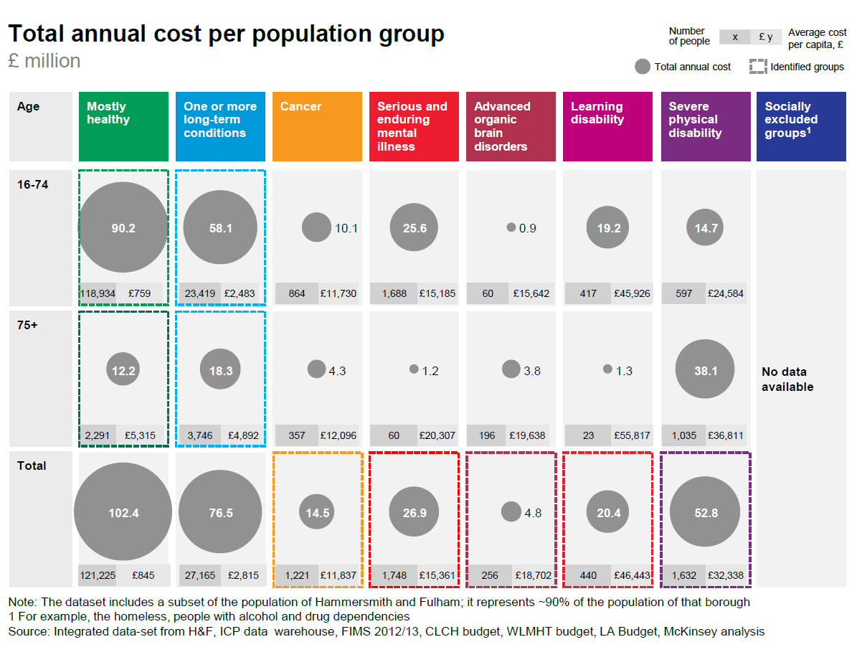
Notes:
https://www.healthiernorthwestlondon.nhs.uk/news-resources/information-sharing/wsictoolkit

Slide 11
Risk stratification
Risk stratification means understanding the people within each segment who are at the greatest risk of having a significant health event or deterioration
Used to support targeting of interventions and to align healthcare to an individual's health needs
Usually conducted at an individual level

Slide 12
Very High 0-0.5%
High 0.5 – 5%
Moderate 5 – 20%
Experience of X over time Y
Low 20 – 100%
Size of population

Slide 13
Risk stratification
Clinical perspective
  using clinical knowledge of patients
Threshold modelling
  picking patients according to a rule e.g. >65 with 2+ hospital admissions in previous 12 months
Predictive modelling
  including multiple regression, decision trees, AI

Slide 14
Predictive models are recommended as they are the most accurate
Examples of predictive modelling tools available are:
  Patients at Risk of Re-hospitalisation: commissioned by Department of Health
  Combined Predictive Model: developed by King’s Fund
  Adjusted Clinical Groups: developed by John Hopkins University
  QAdmissions: developed by ClinRisk LTD
These models are reasonably similar in terms of their predictive performance

Slide 15
 | Mostly Healthy Adults | Mostly Healthy +65 | Mostly Healthy +75 (Frail) | LTC (adult) | LTC (>65) | 2 LTC (adult) | 2 LTC (>65) | Cancer
Acute | 10411 | 1219 | 857 | 5004 | 1606 | 5015 | 8277 | 7530
CC | 461 | 278 | 162 | 521 | 196 | 453 | 954 | 255
SC | 530 | 61 | 122 | 850 | 554 | 1252 | 3649 | 1403
MH | 1096 | 39 | 22 | 845 | 42 | 532 | 226 | 253
GP | 3331 | 262 | 120 | 1706 | 374 | 1454 | 1503 | 754
RX | 682 | 103 | 80 | 1139 | 397 | 1649 | 2382 | 826
Pop (‘000) | 27,834 | 1,322 | 564 | 6,060 | 1,590 | 2,464 | 2,555 | 1,244
Spend (£m) | 16,724 | 1,987 | 1,382 | 10,794 | 4,882 | 8,538 | 15,517 | 11,179

Slide 16
Next
Why this may not work!
Impactibility
Case finding
Bias
Data quality

Slide 17


Slide 18
 | Mostly Healthy Adults | Mostly Healthy +65 | Mostly Healthy +75 (Frail) | LTC (adult) | LTC (>65) | 2 LTC (adult) | 2 LTC (>65) | Cancer
Acute | 10411 | 1219 | 857 | 5004 | 1606 | 5015 | 8277 | 7530
CC | 461 | 278 | 162 | 521 | 196 | 453 | 954 | 255
SC | 530 | 61 | 122 | 850 | 554 | 1252 | 3649 | 1403
MH | 1096 | 39 | 22 | 845 | 42 | 532 | 226 | 253
GP | 3331 | 262 | 120 | 1706 | 374 | 1454 | 1503 | 754
RX | 682 | 103 | 80 | 1139 | 397 | 1649 | 2382 | 826
Pop (‘000) | 27,834 | 1,322 | 564 | 6,060 | 1,590 | 2,464 | 2,555 | 1,244
Spend (£m) | 16,724 | 1,987 | 1,382 | 10,794 | 4,882 | 8,538 | 15,517 | 11,179

Slide 19

$$≠$$
Risk of event over time
Risk
Benefit
Size of population at risk of event
Size of population that could benefit from intervention

Slide 20
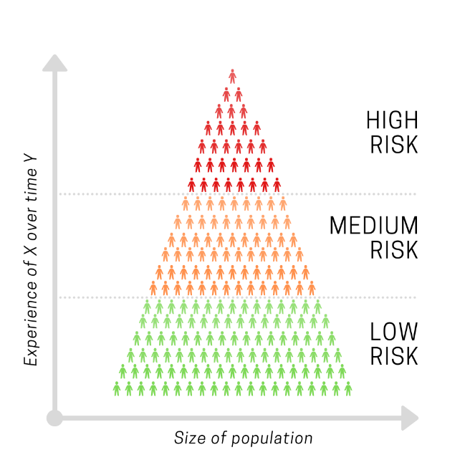
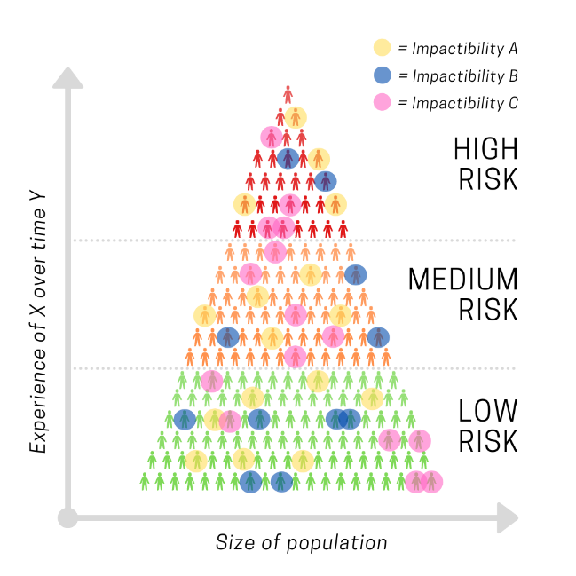

Slide 21
Impactibility modelling
Predicts which high-risk patients are most likely to be responsive to the preventive care intervention being offered.
Approaches to impactibility modelling include:
  Ambulatory Care–Sensitive Conditions
  Gap analysis
  Excluding patients unlikely to respond
  Impactible moments
  Risking risk/deteriorating patient
Notes:
Lewis G.H. “Impactibility models”: Identifying the subgroup of high-risk patients most amenable to hospital-avoidance programs. Milbank Q. 2010;88(2):240–55.
Lewis G. Next Steps for Risk Stratification in the NHS. NHS England; 2015 Jan.
Hawkins K, Ozminkowski RJ, Mujahid A, Wells TS, Bhattarai GR, Wang S, et al. Propensity to Succeed: Prioritizing Individuals Most Likely to Benefit from Care Coordination. Population Health Management. 2015 Dec;18(6):402–11.
Knabel T, Louwers J. Intervenability: another measure of health risk. By coupling predictive modeling with evidence-based medicine, health plans can identify patients who will benefit the most from care management intervention. Health management technology. 2004 Jan 7;25(7):36,38,39.
Mattie H, Reidy P, Bachtiger P, Lindemeer E, Jouni M, Panch T. A Framework for Predicting Impactability of Healthcare Interventions Using Machine Learning Methods, Administrative Claims, Sociodemographic and App Generated Data. Boston, Massachusetts; 2019.
Freund T, Wensing M, Geissler S, Peters-Klimm F, Mahler C, Boyd CM, et al. Primary care physicians’ experiences with case finding for practice-based care management. Am J Manag Care. 2012 Apr 1;18(4):e155-161.
Population Health Management Flatpack. A guide to starting Population Health Management. NHS England, Public Health England, NHS Digital; 2018 Sep. Report No.: Version 1.0.

Slide 22
Ambulatory Care–Sensitive Conditions
Increase the impact of predictive risk models by giving priority to patients with certain diagnoses amenable to upstream care

Slide 23
Gap analysis
Defined as an evidence-based intervention that would be expected for this individual patient but has not been delivered
  such as a test, immunisation or treatment
  Prioritising patients with a high gap-score
  Prioritising patients with a high weighted gap score
Notes:
Prioritising patients with a high weighted gap score
same as above but weighted different gaps depending on how important they are to a patient’s care

Slide 24
Excluding patients unlikely to respond*
De-prioritise/excluding patients with
  stable characteristics (e.g. expensive, long-term drug)
  extremely high risk e.g. in the top strata
  characteristics (psychosis, language barrier)
*NOT a recommended technique but useful to compare
  or use this method to help address inequalities

Slide 25
Impactable moments and rising risk
Impactable moments
  (e.g. post discharge from hospital)
Rising risk score
  (rate of change of risk score)
Patient Activation Measure
  e.g. how ready people are for healthcare

Slide 26
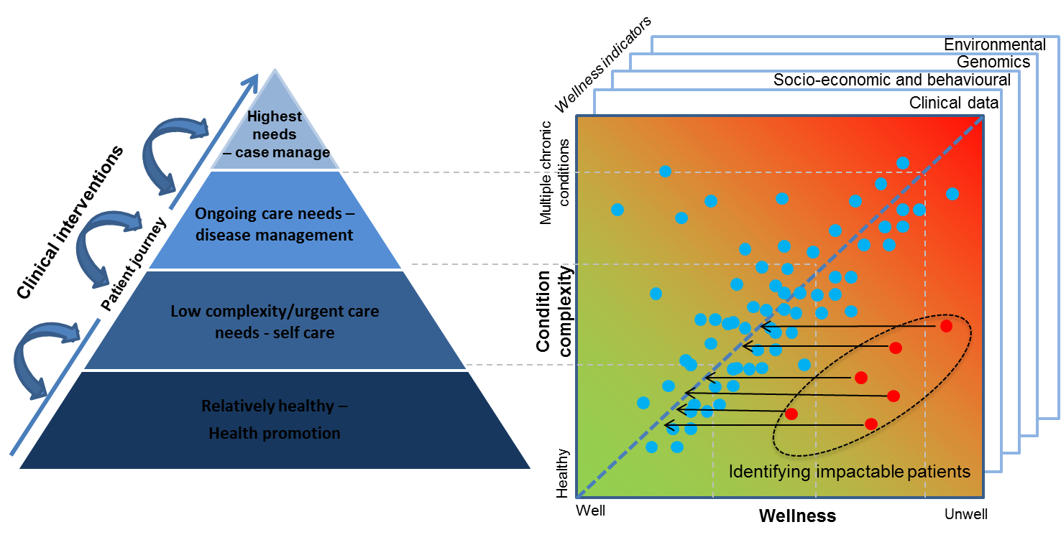

Slide 27
Notes:
Propensity score matched cohort studies

Slide 28
Notes:
Propensity score matched cohort studies

Slide 29
Notes:
Propensity score matched cohort studies

Slide 30
Notes:
Propensity score matched cohort studies

Slide 31
Data issues

Slide 32
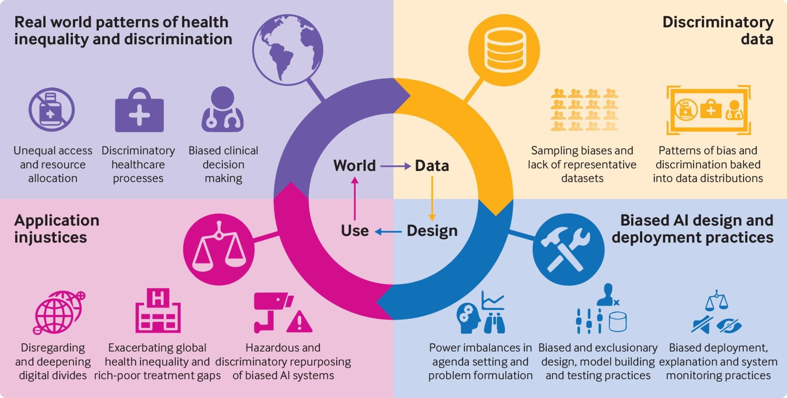
Notes:
https://www.bmj.com/content/372/bmj.n304?utm_source=twitter&utm_medium=social&utm_term=hootsuite&utm_content=sme&utm_campaign=usage

Slide 33
Questions?

