Slide 1
How allocative value can identify the most effective ways for ICSs to use their resources
The role of health, wellbeing and the wider determinants of health and the risks over medicalisation of PHM
The challenges of system working and creating a common language for change
The critical role of finance
Andi Orlowski
Director of the Health Economics Unit
Senior Population Health Analytics Advisor – NHS England (Data and Analytics Directorate)

Slide 2
From focussing on illness to promoting health

Slide 3
Notes:
Medical care accounts for only 20 per cent of modifiable contributors to population health.⁴ These social determinants of health (SDH) ‒ the conditions in which people are born, grow, live, work and age ‒ also contribute. Individual health behaviours contribute around 30 per cent of modifiable factors, socioeconomic factors roughly 40 per cent, and physical environment around 10 per cent.
Hood CM, Gennuso KP, Swain GR, Catlin BB. County health rankings: relationships between determinant factors and health outcomes. Am J Prev Med 2016; 50: 129‒135. https://doi.org/10.1016/j.amepre.2015.08.024.

Slide 4
Wider determinants
1 in 5 dwellings doesn’t meet decent standards in England
1 in 5 people live in poverty in the UK
Children in deprived areas are 9 times less likely to have access to green space and places to play
By the age of 30 those with the highest levels of education are expected to live 4 years longer than those with the lowest education

Slide 5
Life expectancy
Men
Disease free life expectancy
~55 (highest deprivation) to ~70 (least deprivation)
Life expectancy
~74 (highest deprivation) to ~84 (least deprivation)
Women
Disease free life expectancy
~55 (highest deprivation) to ~72 (least deprivation)
Life expectancy
~78 (highest deprivation) to ~86 (least deprivation)
https://www.health.org.uk/publications/reports/the-marmot-review-10-years-on?

Slide 6
Although access to care is a necessary component of population health we need concerted action in
income security
education
housing
nutrition/food security
the environment
These are critical in efforts to improve health among socially disadvantaged populations.
Notes:
https://www-healthaffairs-org.iclibezp1.cc.ic.ac.uk/doi/pdf/10.1377%2Fhlthaff.26.5.1253
https://www.milbank.org/quarterly/articles/the-medicalization-of-population-health-who-will-stay-upstream/
Conrad, P., 2005. The Shifting Engines of Medicalization. Journal of Health and Social Behavior 46, 3–14.. doi:10.1177/002214650504600102
https://assets.publishing.service.gov.uk/government/uploads/system/uploads/attachment_data/file/265503/ih.pdf

Slide 7
Beware of medicalisation
Is population health management paying attention to the upstream institutional, systemic, and public policy drivers of population health problems and distributional disparities?
What is being done about the wider determinants?
Notes:
Before the emergence of population health management, population health was primarily focused on the social structural, systemic, and sociopolitical forces that push people into rivers of bad health according to their racial or ethnic backgrounds, their socioeconomic position, their place of residence, and other social factors.
However, this historical upstream focus of the field is shrugged off by most population health management efforts as being outside of its purview because it is outside of the health care system and its usual partners.
https://www.milbank.org/quarterly/articles/the-medicalization-of-population-health-who-will-stay-upstream/

Slide 8
Upstream/Macro
Greater medicalization
Proportion of effort
Proportion of effort
Downstream/Micro

Slide 9
Improving social and economic factors: Wakefield
Reducing homelessness
Wakefield have been working as a partnership to prevent eviction and potential homelessness
Mental health navigators take referrals from Wakefield District Housing Debt Team, housing officers and community safety officers on problems like hoarding, poor tenancy management and anti-social behaviour.
The team engaged with over 150 clients and the wellbeing caseworkers carried out over 400 interactions yielding a social return of £1.1 million.
Notes:
Looking at socio- economic factors – relating for 40% of modifiable health determinants a great example is Wakefield partnership
Wakefield have been working as a partnership to prevent eviction and homelessness
People affected by homelessness die, on average, around 30 years earlier than the general population – that includes who are in sheltered housing so not just those who are sleeping rough
The process works by MH navigators taking referrasl from the housing debt team and work with people to prevent homelessness
The team engaged with over 150 individuals which yilded a social return of 1.1. million

Slide 10
Improving the physical environment: London
Traffic calming measures for public health benefit
Guy’s and St Thomas’ charity paid £250k to install traffic calming measures for public health benefits including tackling air pollution and obesity in Lambeth and Southwark
The Low Traffic Neighbourhoods will be focused in the areas of highest deprivation in the area
The aim is to reduce traffic and improve access for cyclists and pedestrians - including widening pavements, adding seating and roadside markings to encourage walking and cycling and removing parking spaces.
Notes:
https://www.theguardian.com/environment/2020/nov/17/london-hospital-trust-to-pay-250k-to-install-ltn-for-public-health-benefits

Slide 11
Improving the physical environment: North East
Improving homes in Sunderland and Scotland
Gentoo and Sunderland CCG provided energy efficient boilers, double glazing and insulation on ‘prescription’
A&E attendances reduced by 30%. Emergency admissions reduced by 25%. GP appointments reduced by 60%
Patients suffering from respiratory diseases that are exacerbated by the cold, such as COPD, were referred onto the scheme and received improvements totalling on average £5,000 per property.
Notes:
https://www.gentoogroup.com/media/1061811/boiler-on-prescription-closing-report.pdf
https://www.gmjournal.co.uk/boilers-on-prescription-scheme-reduces-gp-appointments-by-60

Slide 12
Delivering on the promise of systems

Slide 13
There is little convincing evidence to suggest that collaboration between local health care and non-health care organisations improves health outcomes
Alderwick, H., Hutchings, A., Briggs, A. et al. The impacts of collaboration between local health care and non-health care organizations and factors shaping how they work: a systematic review of reviews. BMC Public Health 21, 753 (2021). https://doi.org/10.1186/s12889-021-10630-1
Notes:
Alderwick, H., Hutchings, A., Briggs, A. et al. The impacts of collaboration between local health care and non-health care organizations and factors shaping how they work: a systematic review of reviews. BMC Public Health 21, 753 (2021). https://doi.org/10.1186/s12889-021-10630-1
Aunger, J.A., Millar, R., Greenhalgh, J. et al. Why do some inter-organisational collaborations in healthcare work when others do not? A realist review. Syst Rev 10, 82 (2021). https://doi.org/10.1186/s13643-021-01630-8
https://assets.publishing.service.gov.uk/government/uploads/system/uploads/attachment_data/file/265503/ih.pdf

Slide 14
Alderwick, H., Hutchings, A., Briggs, A. et al. The impacts of collaboration between local health care and non-health care organizations and factors shaping how they work: a systematic review of reviews. BMC Public Health 21, 753 (2021). https://doi.org/10.1186/s12889-021-10630-1
Notes:
Alderwick, H., Hutchings, A., Briggs, A. et al. The impacts of collaboration between local health care and non-health care organizations and factors shaping how they work: a systematic review of reviews. BMC Public Health 21, 753 (2021). https://doi.org/10.1186/s12889-021-10630-1
Factors influencing collaboration functioning and example interactions between themNotes: The interactions between factors are examples identified in the studies reviewed. They are not an exhaustive list of all interactionsbetween the factors identified. The relationships may move in both directions (eg involving staff may help create a shared vision, while having ashared vision may help with the task of engaging other partners), and may support or constrain collaboration in different contexts (eg nationalpolicies can help or hinder)
Alderwicket al. BMC Public Health (2021) 21:753

Slide 15
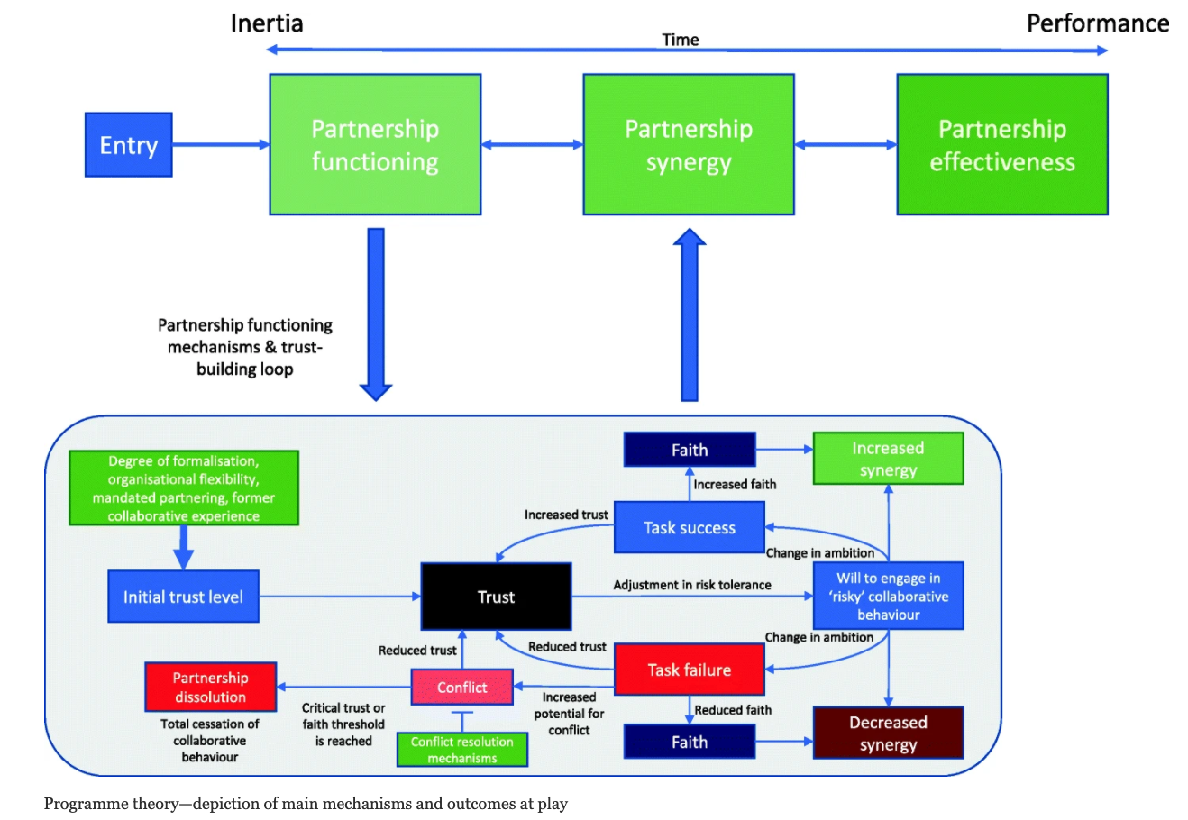
Aunger, J.A., Millar, R., Greenhalgh, J. et al. Why do some inter-organisational collaborations in healthcare work when others do not? A realist review. Syst Rev 10, 82 (2021). https://doi.org/10.1186/s13643-021-01630-8
Notes:
Aunger, J.A., Millar, R., Greenhalgh, J. et al. Why do some inter-organisational collaborations in healthcare work when others do not? A realist review. Syst Rev 10, 82 (2021). https://doi.org/10.1186/s13643-021-01630-8

Slide 16
Resetting our approach to finance to embed change

Slide 17
Allocative efficiency
Allocative efficiency is a health economics term about doing the right amount of the right things.
Tweak budgets and resources
Leading to maximised Population Health
Social determinants
Behaviours
Environment
Clinical care
Notes:
A pathway is allocatively efficient when the allocation of resources is such that it is not possible to gain more value by switching a single pound from one budget to another.

Slide 18
What is Socio-Technical Allocation of Resources?
STAR is a structured and transparent way of setting priorities through synthesising the views of key stakeholders and is informed by using the best available data.
‘Socio’ part
The social process entails engaging local, key stakeholders (including patients, clinicians, and managers) in building a view of the current pathway and model improvements. This is done with the help of a facilitator and visual models.
‘Technical’ part
The technical process entails the use of visual models based in health economic principles that can incorporate multiple criteria.
Population health gain
Health gain
Number who benefit
Cost per case
Costs
Numbers treated
Notes:
Triangles with a steep slope have a higher value for money than those with a shallower slope.
The x-axis represents costs – calculated using number treated and cost per case
The y-axis represents population health gain – calculated using numbers who benefit and individual health gain
Refs:
Airoldi, M., Morton, A., Smith, J. A. E., & Bevan, G. (2014). STAR - People-powered prioritization: A 21st-century solution to allocation headaches. Medical Decision Making, 34(8). https://doi.org/10.1177/0272989X14546376

Slide 19
The STAR process
Develop a comprehensive understanding of the pathway
Facilitate discussions between people with experience, clinicians, managers and commissioners to understand and value the pathway and reach a consensus on priorities
Model the initiatives prioritised in the decision conferences to assess their impact on the pathway
Pathway mapping
Valuing interventions
Efficiency Frontier
Setting priorities
Modelling initiatives
Decision conferences
Determine how much health was improved by each of the interventions that make up the pathway
Facilitate conversations about improving the pathway, based on graphs comparing the health improvement and costs of each intervention
Reach consensus about the initiatives that could be taken forward to improve the pathway
Notes:
(Ballweg, 2017)

Slide 20
Why STAR?
STAR is a method that can help determine priorities through a technical value-for-money analysis with extensive stakeholder engagement.
STAR provides a structured way to bring stakeholders together to think about allocating resources across the entirety of a pathway through decision conferencing (DCs) and the building of visual models.
Clinical care accounts for ~20% of modifiable contributors to population health. STAR allows consideration of the full pathway, including all modifiable health determinants.
Notes:
Hood CM, Gennuso KP, Swain GR, Catlin BB. County health rankings: relationships between determinant factors and health outcomes. Am J Prev Med 2016; 50: 129‒135. https://doi.org/10.1016/j.amepre.2015.08.024.

Slide 21
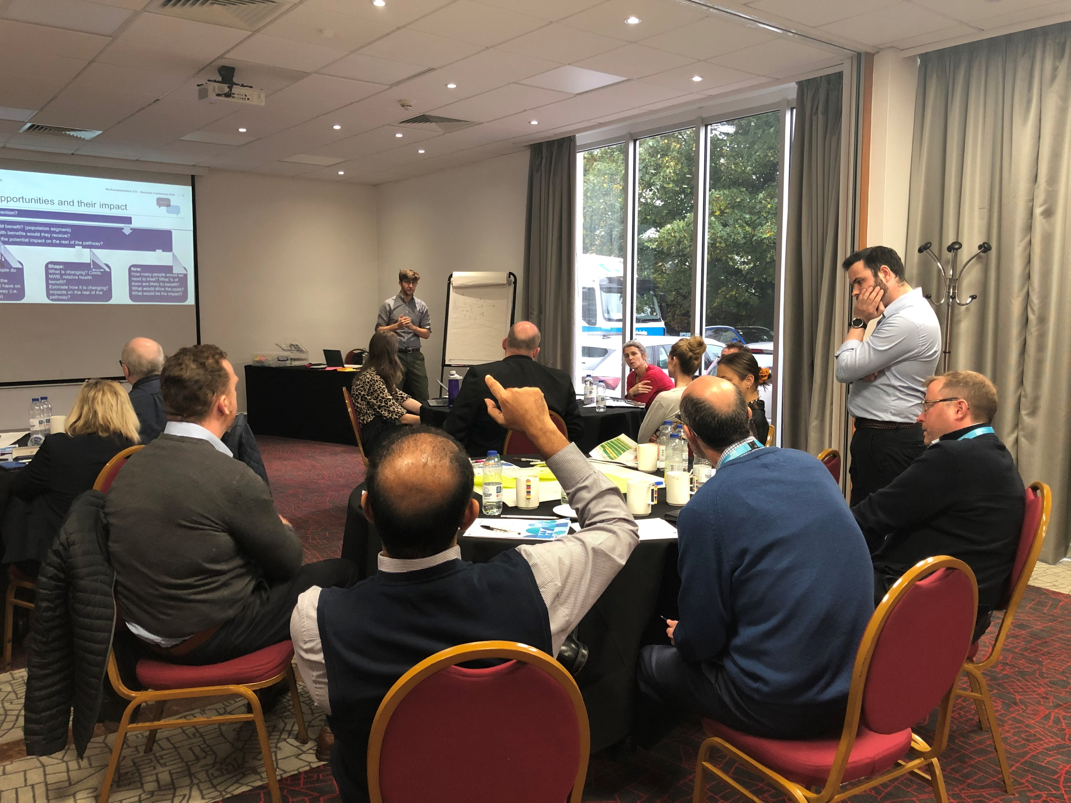
‘Socio’ bit
What is decision conferencing?
Decision conferencing is a way of “helping a group of key players to resolve important issues in their organisation by working together, under the guidance of an impartial facilitator with the aid of a decision analysis model of participants”. Lawrence D. Phillips, London School of Economics – Operational Research Group
Its use in STAR
For STAR, decision conferencing is used to bring stakeholders together to gain consensus about the current situation and priorities for the future.
Notes:
http://eprints.lse.ac.uk/22712/1/06085.pdf

Slide 22
‘Technical’ bit
Intervention
Each triangle represents an intervention or package of care.
The steeper the slope, the higher the value for money.
A triangle has cost across the x-axis and population health gain across y-axis.
Population health gain
Benefit
Number who benefit
Cost per case
Costs
Numbers treated
Efficiency frontier = the pathway
The triangles (interventions) are then ordered by their value for money (highest to lowest) to create a view of the entire pathway, known as an efficiency frontier.
This is an easy-to-interpret visualisation of where the value in a pathway lies.
Costs, benefits and numbers who benefit and numbers treated were sourced from data, literature and expert knowledge.
Lowest value for money
POPULATION HEALTH GAIN
Highest value for money
COSTS
Notes:
(Airoldi et al., 2014; The Health Foundation, n.d.)
https://www.valueinhealthjournal.com/article/S1098-3015(20)32134-3/fulltext

Slide 23
An example of the STAR outputs from the falls pathway
90% spend drives 50% of value
Question: Are there better ways of allocating resources to support your population?
Notes:
This efficiency frontier shows all interventions along a pathway – with each triangle representing an intervention.
This graph helps to aid conversations and prioritisation in the decision conferences.
The goal is to increase the population health benefit and, where appropriate, reduce costs
Refs:
Airoldi, M., Morton, A., Smith, J. A. E., & Bevan, G. (2014). STAR - People-powered prioritization: A 21st-century solution to allocation headaches. Medical Decision Making, 34(8). https://doi.org/10.1177/0272989X14546376

Slide 24
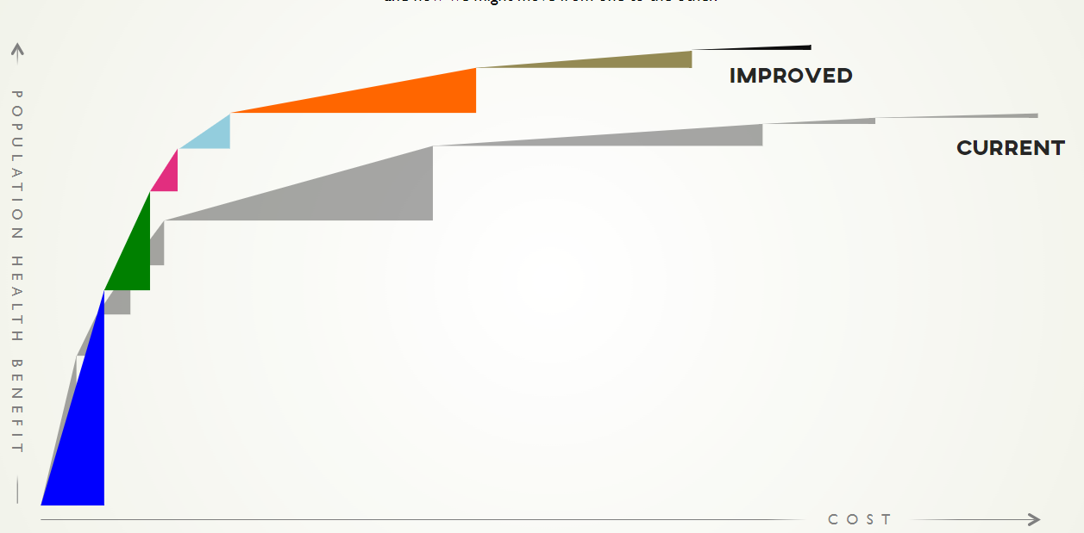
How can STAR support the improvement of a pathway?
The STAR approach helps identify where value lies in a particular pathway and determines how the pathway can be improved.
It allows decision makers to select interventions of best value for money (reduced cost / increased population health gain.
STAR can also be used to assess priorities across a portfolio of investments across multiple pathways.
Notes:
STAR tutorial 2017.
Airoldi, M., Morton, A., Smith, J. A. E., & Bevan, G. (2014). STAR - People-powered prioritization: A 21st-century solution to allocation headaches. Medical Decision Making, 34(8). https://doi.org/10.1177/0272989X14546376

Slide 25
Meanwhile in the real world…

Slide 26
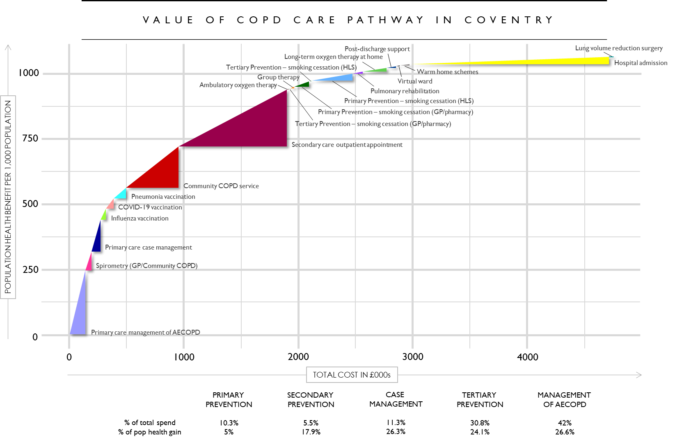

Slide 27
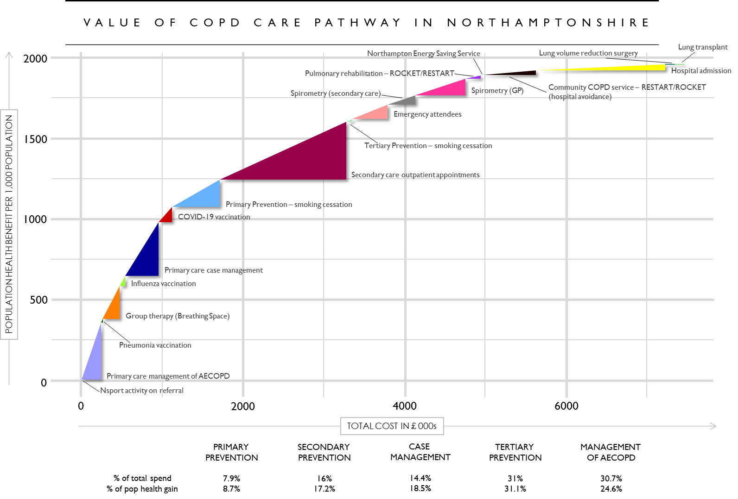

Slide 28
Process
Executive Summary: Smarter Spending in Population Health
The project aimed to understand how to increase allocative efficiency of the COPD pathway in Nottinghamshire. It was facilitated through the following process:
Collect data and evidence on the pathway:
>500 COPD patients completed a preferences survey
>64 publications were part of the literature review
>100 data points were collected looking at costs, activity and health gain.
Collaborative workshops to value the pathway and identify improvements:
22 attendees contributed to two in-person workshops
Attendees included patients, COPD clinical specialists, public health, finance, informatics, analysts and transformation.
Model pathway improvements in terms of costs and population health:
11 pathway improvements were modelled using methods validated by LSE
Five pathway improvements are recommended for implementation due to the modelled cost and population health gain.
More details on the project process are on page 12

Slide 29
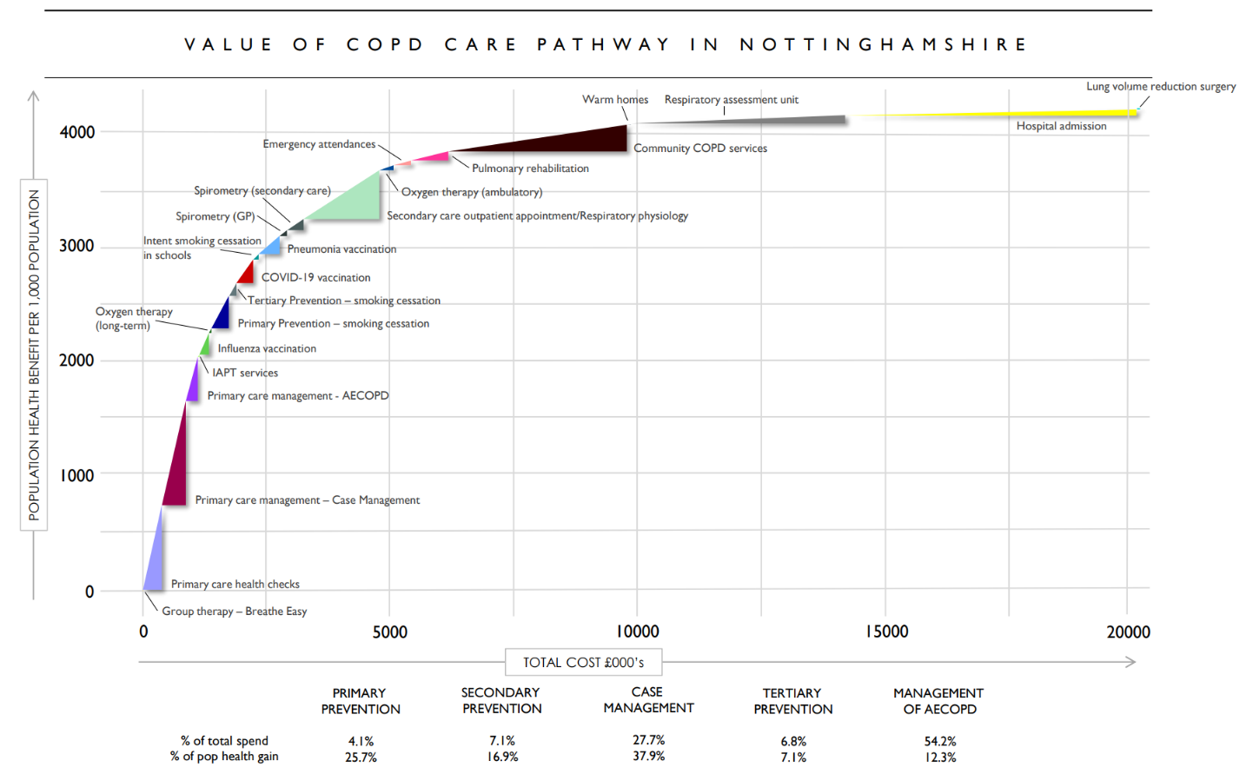

Slide 30
Recommendations
Executive Summary: Smarter Spending in Population Health
The following pathway improvements have been modelled and are recommended for implementation as they are likely to lead to the most health generation per pound spent.
Improving case-finding by targeted COPD screening
Making every contact count – ‘very brief advice’ on smoking cessation
Conducting patient’s yearly reviews through group consultations
Introducing referral pathways to Breathe Easy
Improving uptake to smoking cessation services
Yearly savings through early diagnoses (>£1.3m)
Cost saving through reduction in AECOPDs (~£2,000)
Cost neutral
Inexpensive intervention (<£2,700)
Cost inducing but effective (£69k - £76k)
~2,600 additional cases of COPD identified per year
~243 quitters per year
~6,074 more patients having a yearly review
Large net population health gain for cost
~1,088 more quitters per year
Address priority: Improving case management in primary care
Address priority: Stopping more people from smoking and helping more people to quit
Address priority: Improving case management in primary care
Address priority: Improving uptake of tertiary prevention services
Address priority: Stopping more people from smoking and helping more people to quit
If implemented, these interventions are expected to result in £408k-872k increase on costs and a 34.24 percentage point increase to population health (best case scenario).
More details on intervention, recommendations and next steps on pages 20-38

Slide 31
Process
Executive Summary: Smarter Spending in Population Health
The project aimed to understand how to increase allocative efficiency of the COPD pathway in Gloucestershire. It was facilitated through the following process:
Collect data and evidence on the pathway:
>500 COPD patients completed a preferences survey
>64 publications were part of the literature review
>100 data points were collected looking at costs, activity and health gain.
Collaborative workshops to value the pathway and identify improvements:
28 attendees contributed to two in-person workshops
Attendees included patients, COPD clinical specialists, public health, finance, informatics, analysts and transformation managers.
Model pathway improvements in terms of costs and population health:
12 pathway improvements were modelled using methods validated by LSE
Five pathway improvements are recommended for implementation due to the modelled cost and population health gain.

Slide 32
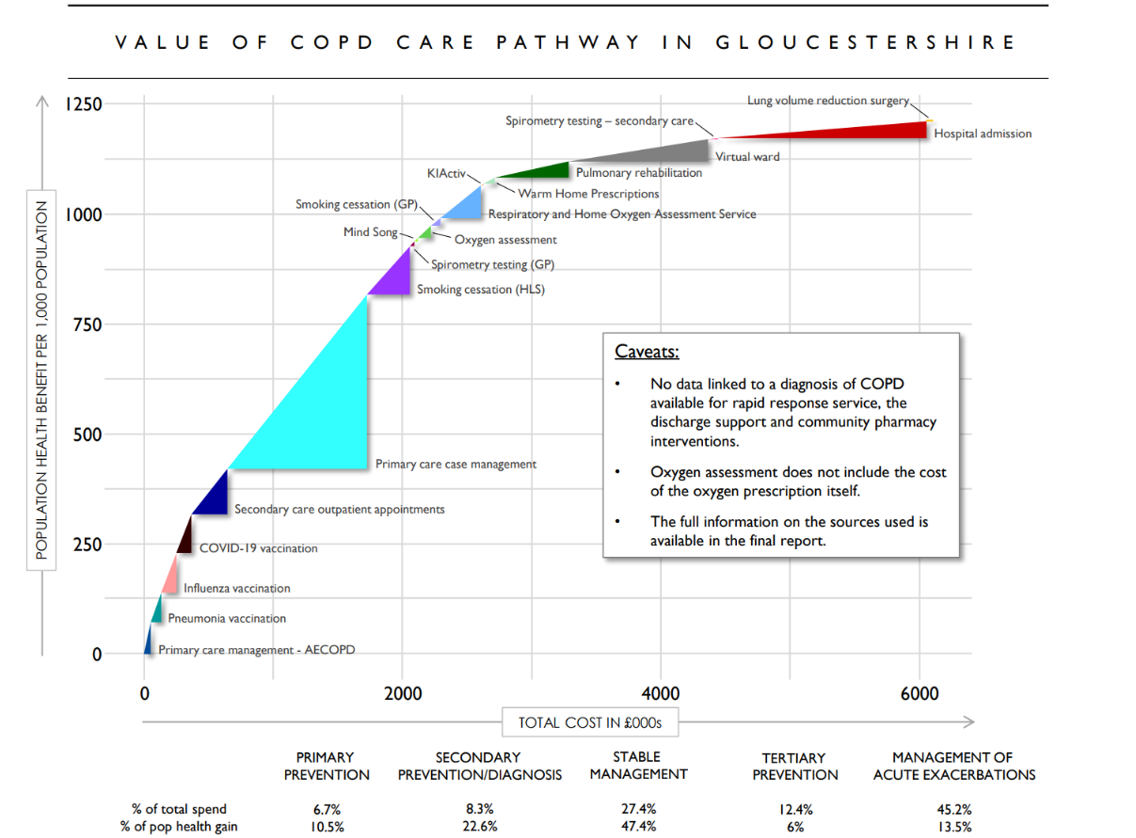

Slide 33
Recommendations
Executive Summary: Smarter Spending in Population Health
The following pathway improvements have been modelled and are recommended for implementation as they are likely to lead to the most health generation per pound spent.
More effective use of the virtual ward
Improving uptake to Mindsong and KiActiv
Proactive case finding
Very brief advice (VBA) for tobacco dependency
Increasing uptake of PR (online offering)
~£2 saved for every £1 spent
Yearly savings through avoided admission (~£2,500)
Possible ~£7 saved for every £1 spent
Cost neutral
~£5 saved for every £1 spent
Reducing risk of hospital acquired infection
102 additional people accessing services
Increased early diagnosis
Linked to a 66% increase in quitting rate
Scalable option to increase PR engagement
Priority addressed: Managing acute exacerbations more efficiently
Priority addressed: Enhancing the role of social prescribing and awareness of services
Priority addressed: More proactive and earlier interventions in primary care
Priority addressed: Creation of a tobacco prevention and treatment alliance
Priority addressed: Enhancing the role of social prescribing and awareness of services
If implemented, these pathway improvements are expected to be cost saving. They are estimated to save £1.04m net per year and lead to a 12.4% percentage point increase to population health.
More details on intervention, recommendations and next steps on pages 20-38

Slide 34
Process
Executive Summary: Smarter Spending in Population Health
The project aimed to understand how to increase allocative efficiency of the COPD pathway in Birmingham and Solihull. It was facilitated through the following process:
Collect data and evidence on the pathway:
>500 COPD patients completed a preferences survey
>64 publications were part of the literature review
>100 data points were collected looking at costs, activity and health gain.
Collaborative workshops to value the pathway and identify improvements:
20 attendees contributed to two workshops
Attendees included COPD clinicians, public health, finance, informatics, analysts and transformation managers.
Model pathway improvements in terms of costs and population health:
13 pathway improvements were modelled using methods validated by LSE
Five pathway improvements are recommended for implementation due to the modelled cost and population health gain.

Slide 35
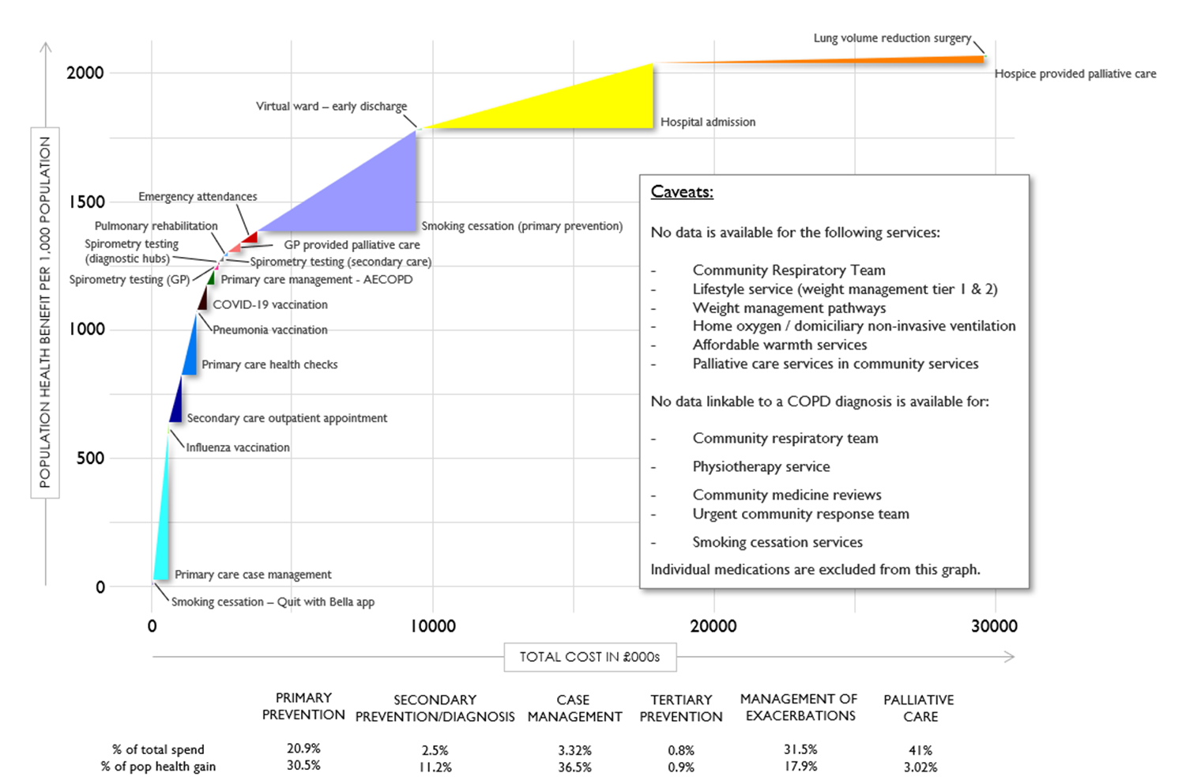
Birmingham

Slide 36
Recommendations
Executive Summary: Smarter Spending in Population Health
The following pathway improvements have been modelled and are recommended for implementation as they are likely to lead to the most health generation per pound spent.
Virtual ward as early discharge support
Expanding spirometry testing
Introducing the myCOPD app
Increasing uptake of smoking cessation services (Tertiary prevention – Quit with Bella app)
Promoting respiratory services within localities through social prescribing – physical activity
Yearly savings through avoided admission (~£1.8m)
Up to £163k savings a year due to early diagnosis
£0.01 for every additional unit of population health gain
£0.23 for every additional unit of population health gain
£0.26 for every additional unit of population health gain
4,194 fewer bed days required for COPD patients per year
94 fewer hospital admissions a year
~11,000 people receiving self care support a year
1 avoided case of COPD for every 88 people who quit
1 hospital admission avoided for every 70 people treated
National priority addressed: Expand virtual wards
Priority addressed: Accurate and timely diagnosis
Priority addressed: Living well
Priority addressed: Prevention and promotion of healthier communities
Priority addressed: Living well
If implemented, these pathway improvements are expected to be cost saving. They are estimated to save ~£1.8m net per year and lead to a 52.46% percentage point increase to population health.
More details on intervention, recommendations and next steps on pages 20-34

Slide 37
Questions
andi.orlowski@nhs.net
https://healtheconomicsunit.nhs.uk/
@andrzeio

